Slide 1
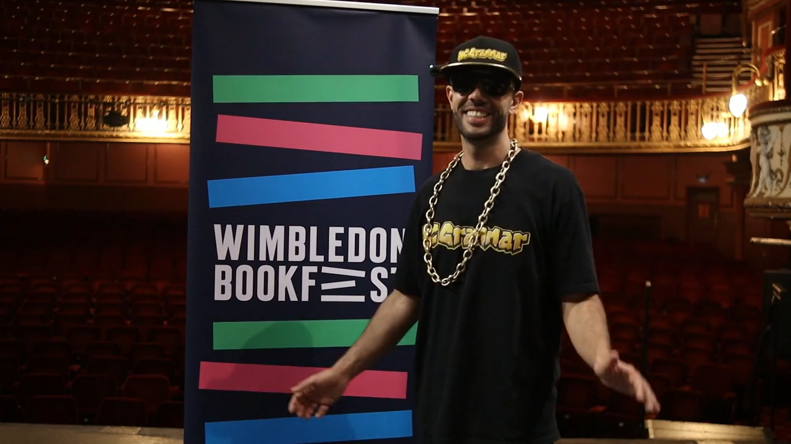

Slide 2

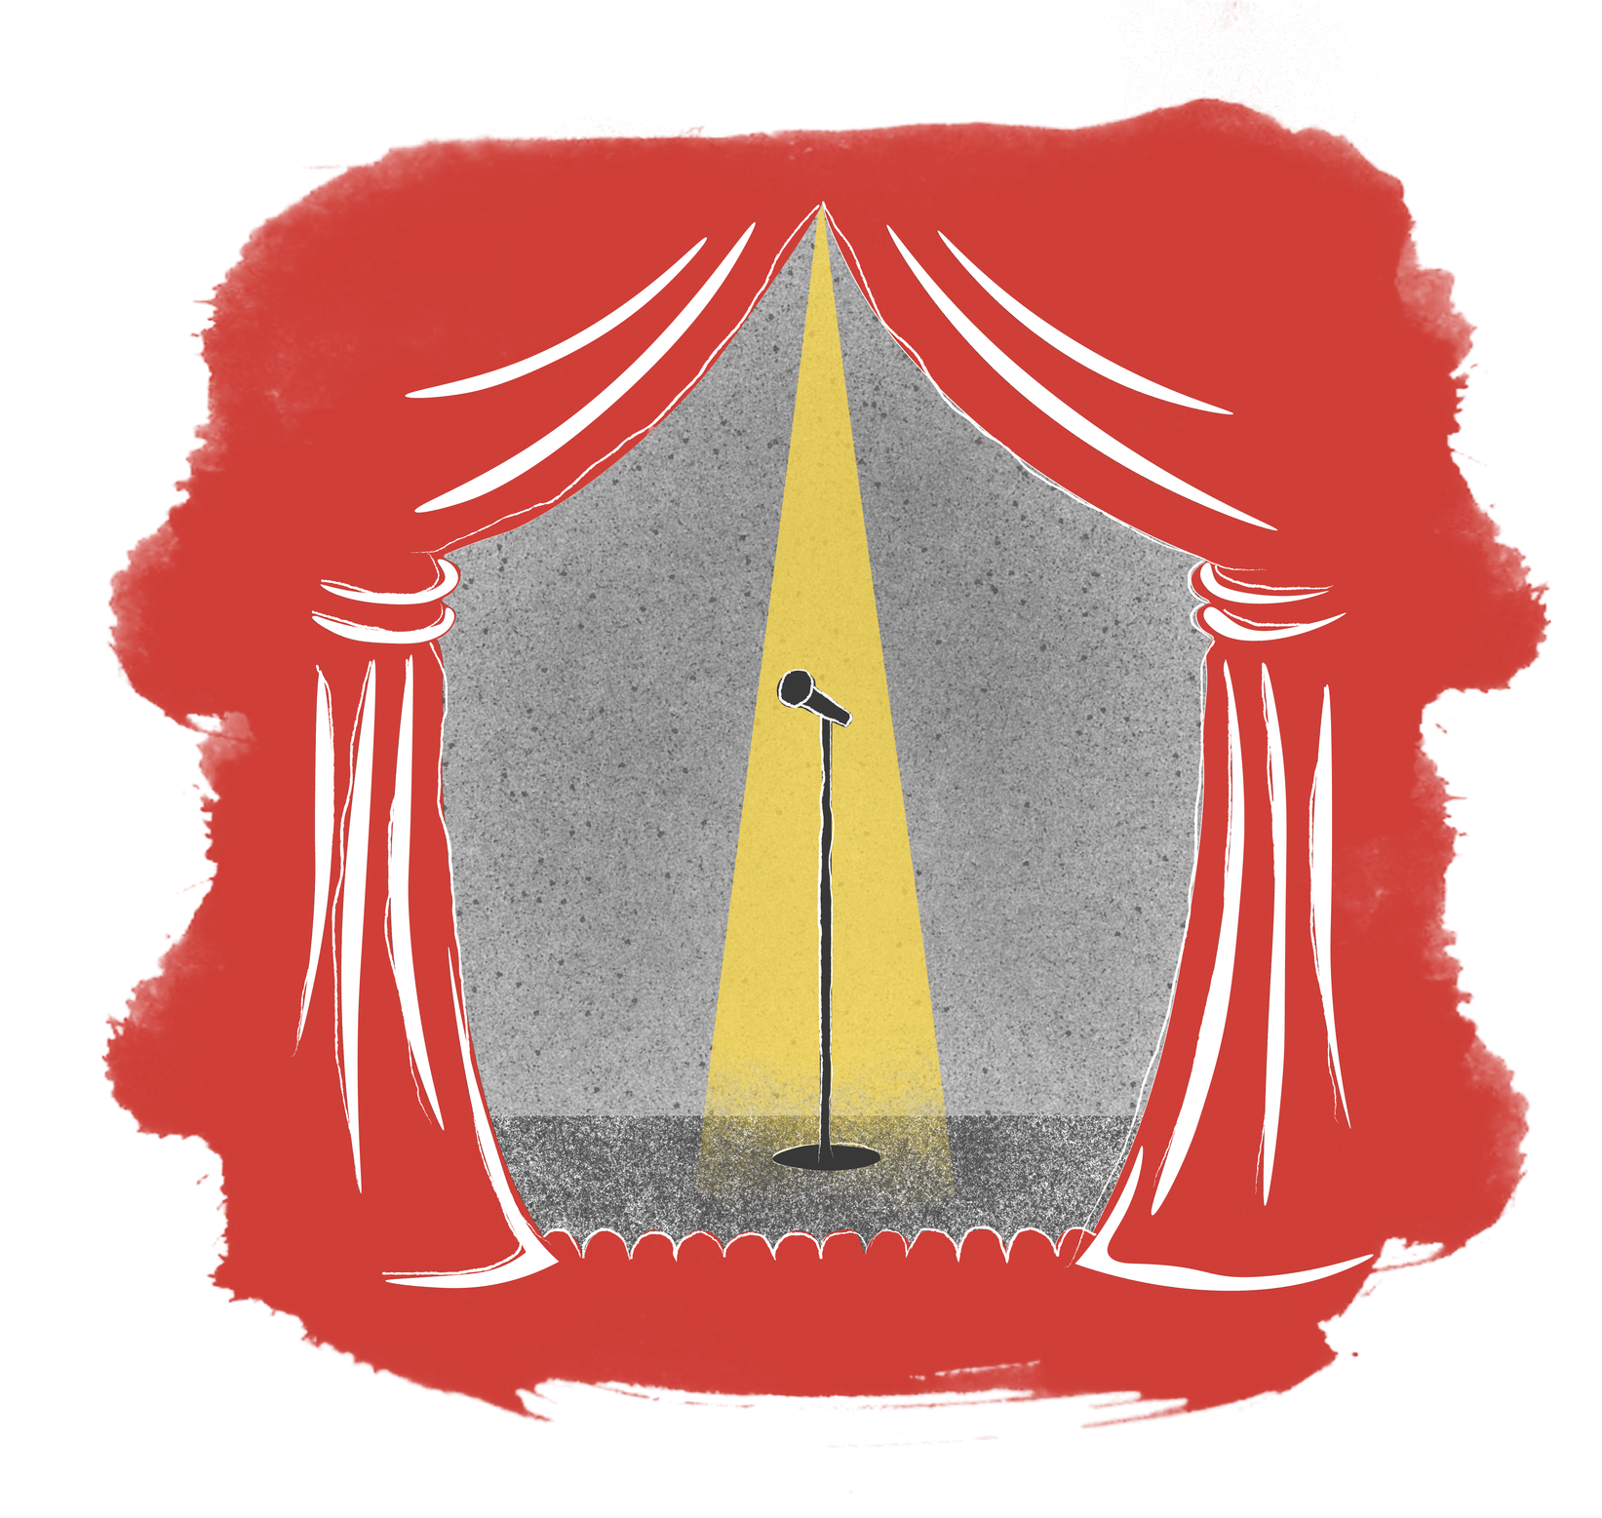

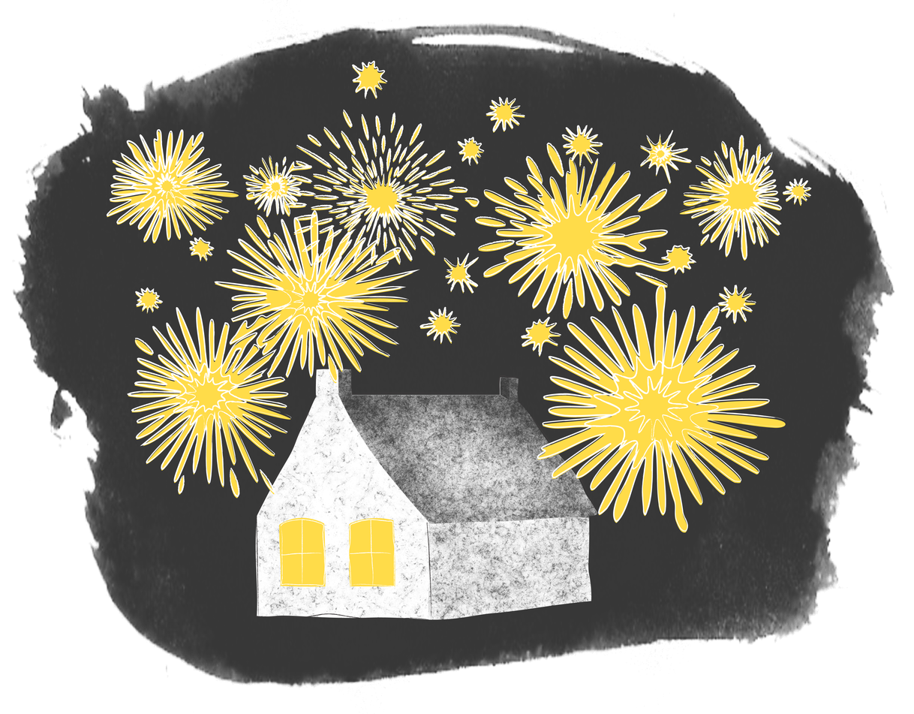
The Light
26
Junior
Young
Writers
Competition
This year, we are inspired by the sources that brighten our world and our theme is:
The Light

Slide 3
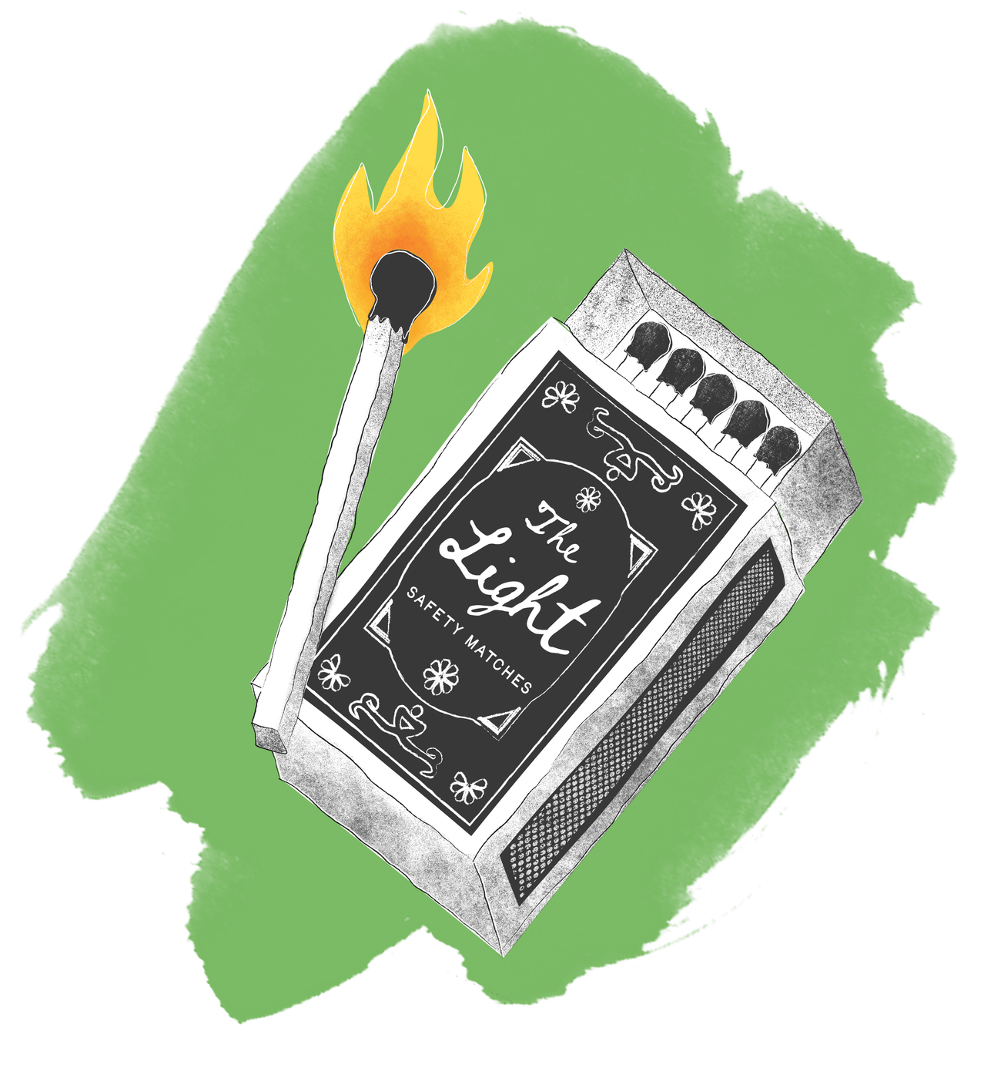
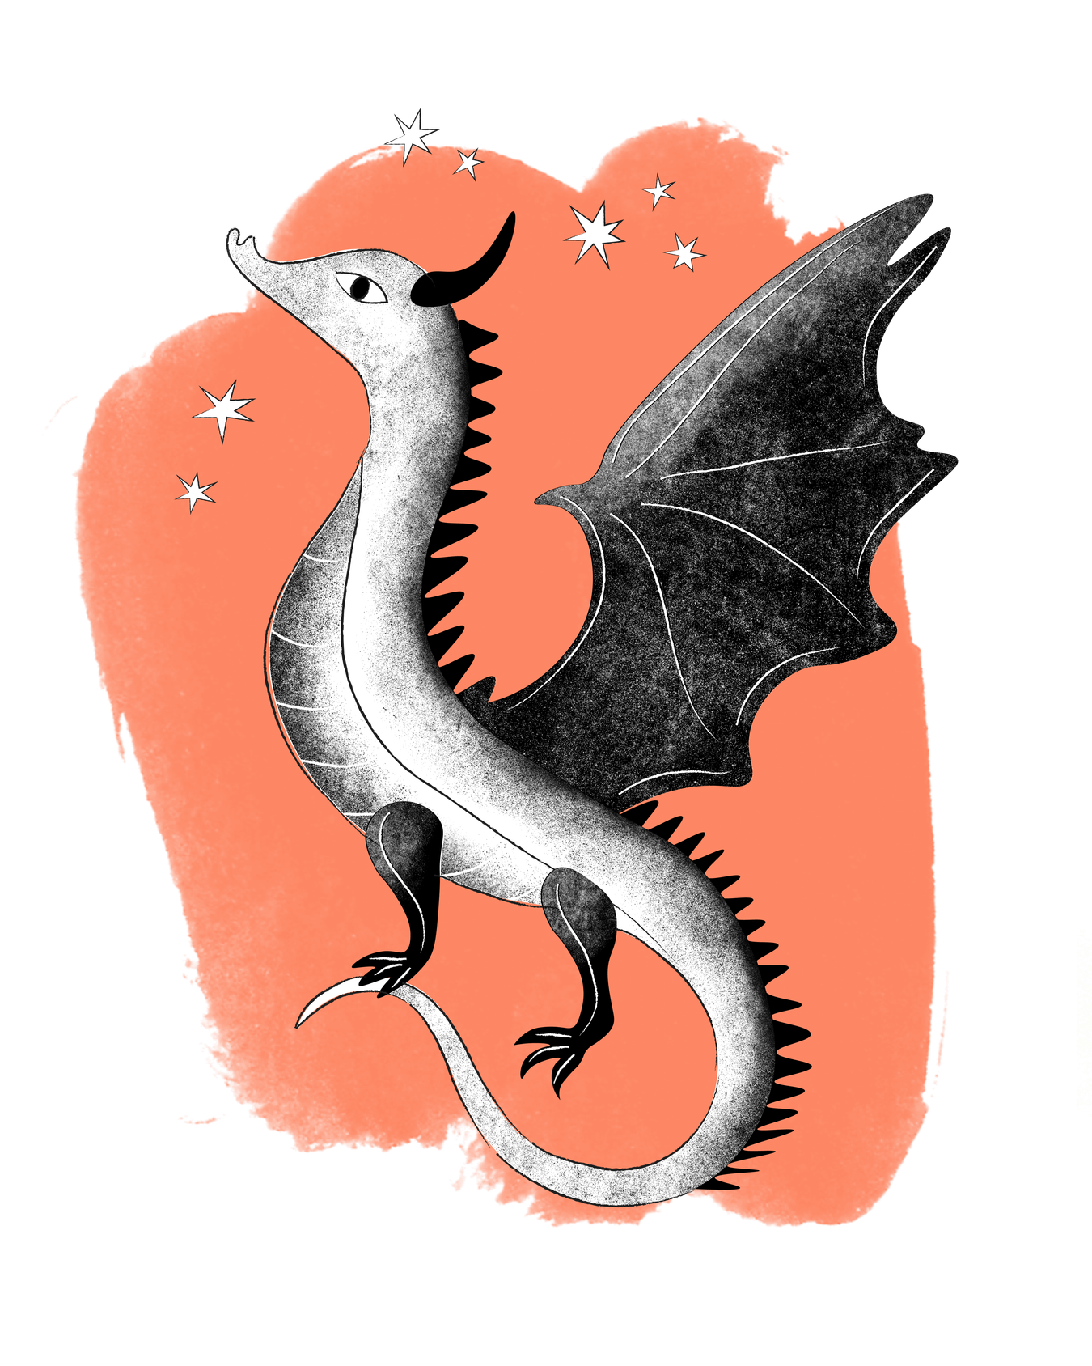
The Light
26
Junior
Young
Writers
Competition
Light exists all around us. It can be natural: the sun and the moon, stars in the night sky, lightning in a storm, or a burning fire. Light can also be manmade: lightbulbs, screens, streetlights, lasers or even the Olympic Torch are all types of light that could inspire your story.
What about magical light? The sparkle of fairies, the flames of a fire-breathing dragon, the glow of a mystical object. What could light represent – hope, a special power or a bright new idea?

Slide 4
The Light
26
Junior
Young
Writers
Competition
Is it a lighthouse in the middle of a sea or a glowing spaceship flying through outer space? Perhaps it is the lights of a football stadium or the spotlight on stage for a dancer, actor or singer. How might you feel when you see these lights?
Many events and celebrations use light - Diwali, Bonfire Night, Hanukkah and Christmas all involve lights from candles to fireworks. How and why do these traditions involve light? Are there any other traditions, or even historical events, that also use light?

Slide 5
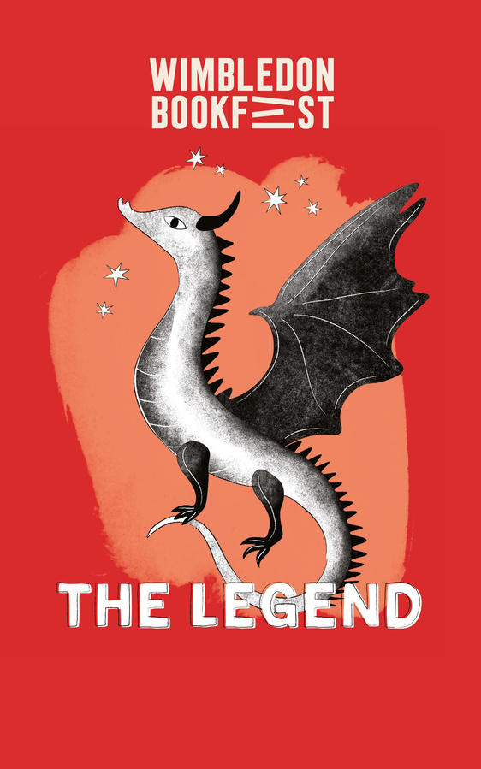
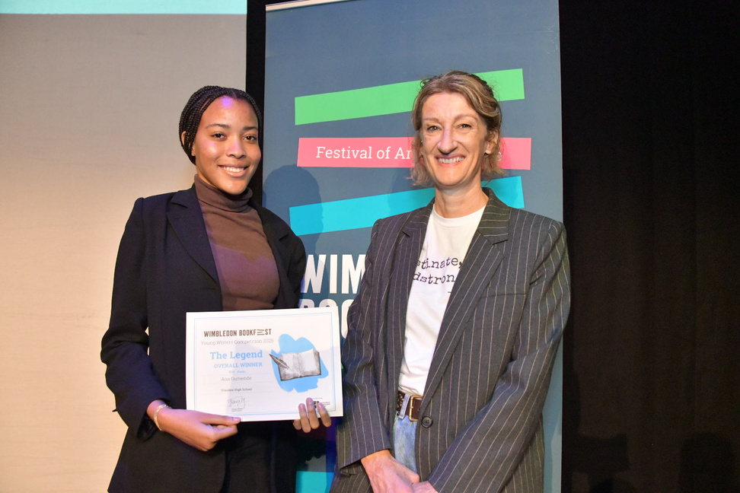
Prizes
26
Junior
Young
Writers
Competition
Every student that is selected by their school will receive a certificate.
Winners, Runners Up and Entrants that receive Distinctions will have their work published in the 2026 Wimbledon BookFest Anthology.
Winners and Runners Up will be invited to our Prize-Giving event at the New Wimbledon Theatre to receive their certificate and a copy of the anthology
One lucky overall competition winner will win an iPad!

Slide 6
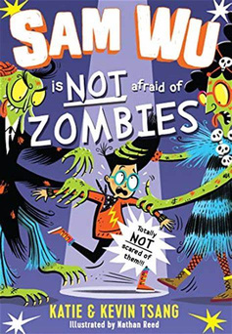
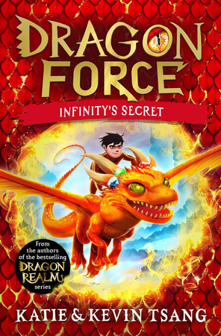
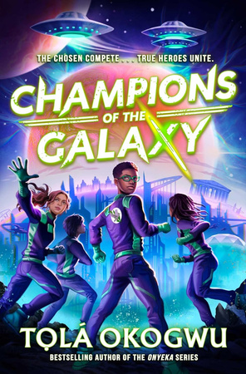
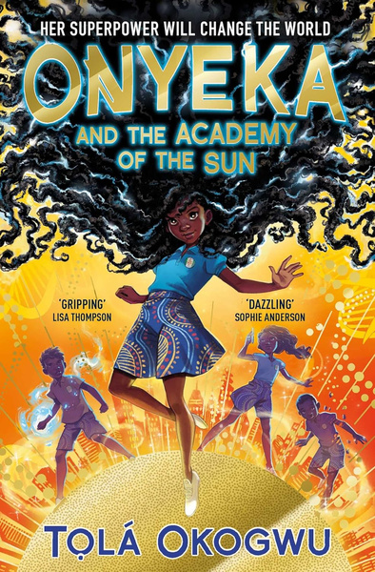
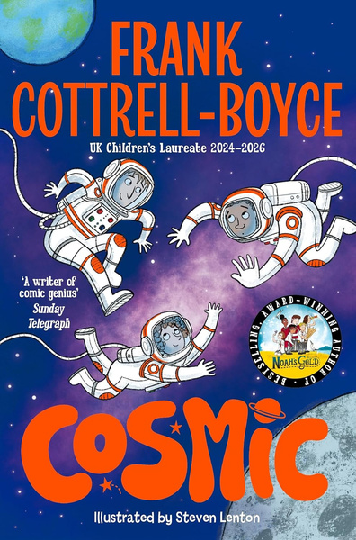
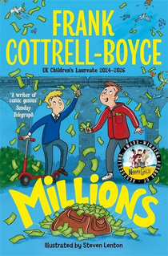
Writing Tips from Authors
26
Junior
Young
Writers
Competition
Here are some writing tips from bestselling and award-winning children’s authors!
Write YOUR story
Don’t be scared of a messy first draft
Just start writing!
Children’s Laureate Frank Cottrell-Boyce says, “Don’t worry about having a perfect idea before you begin - just start writing and ideas will come!”
Even if you don’t have the perfect idea, just writing will help to get your imagination going.
“Write what excites you and it will come across on the page.”
Kevin & Katie Tsang advise writers to think about what you love and use that as the inspiration - your favourite stories, your hobbies, your friends and family – anything you feel passionate about.
Tọlá Okogwu says not to worry about getting the perfect story first time.
“First drafts are supposed to be messy! No one is going to see it but you. Just get all your ideas on the page - you can edit and find the perfect words later.”

Slide 7
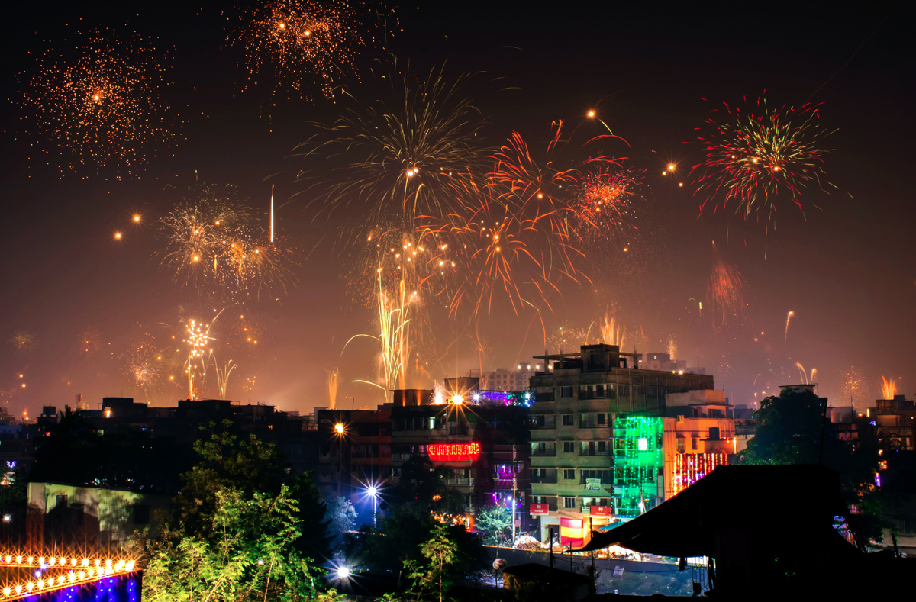
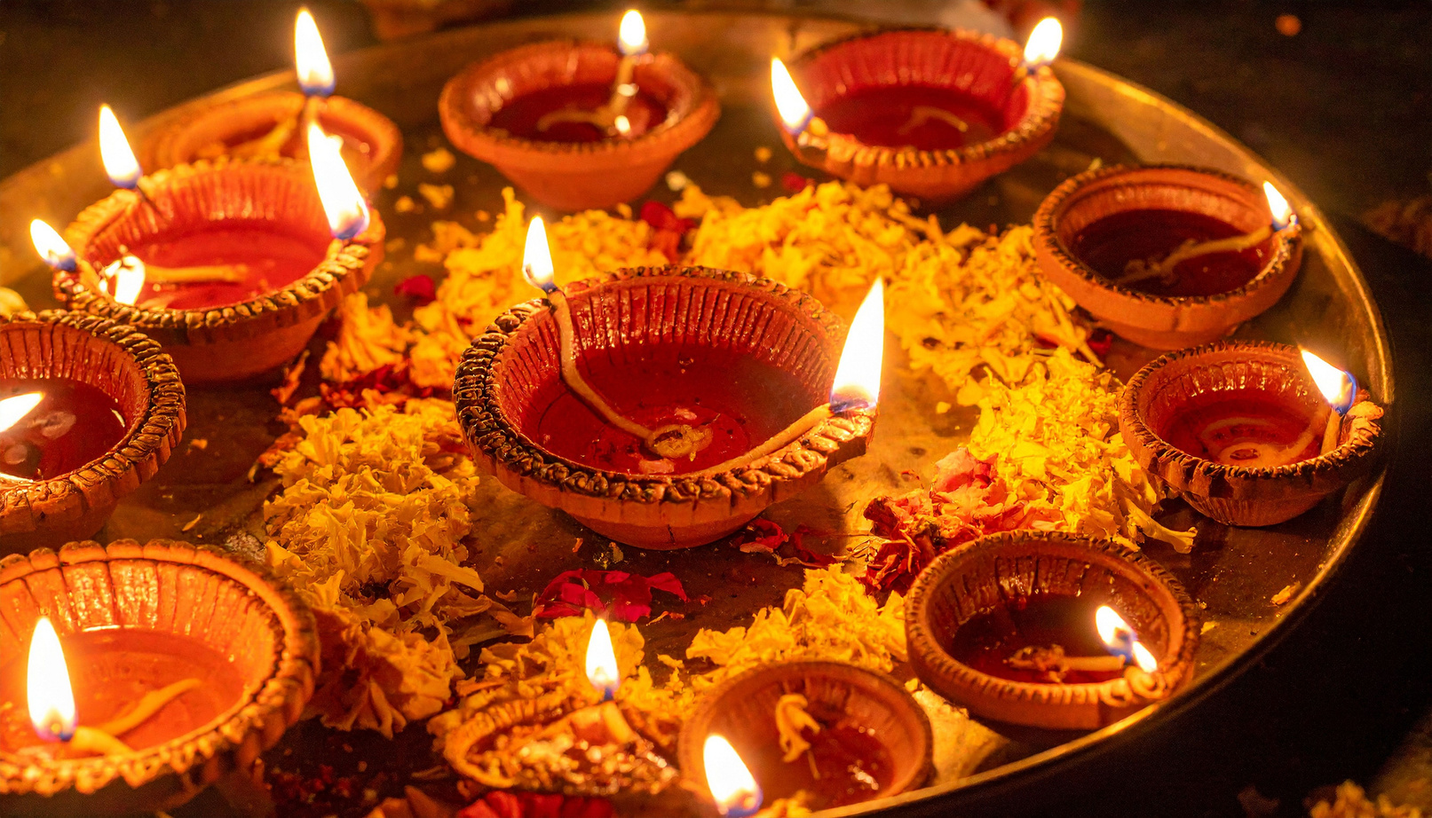
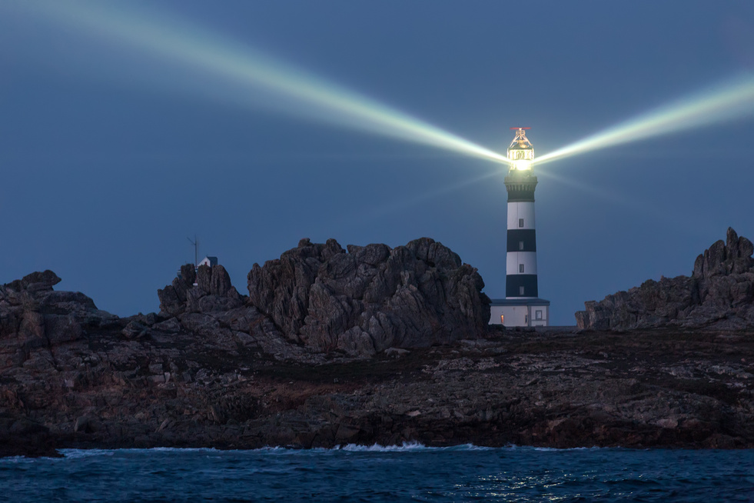
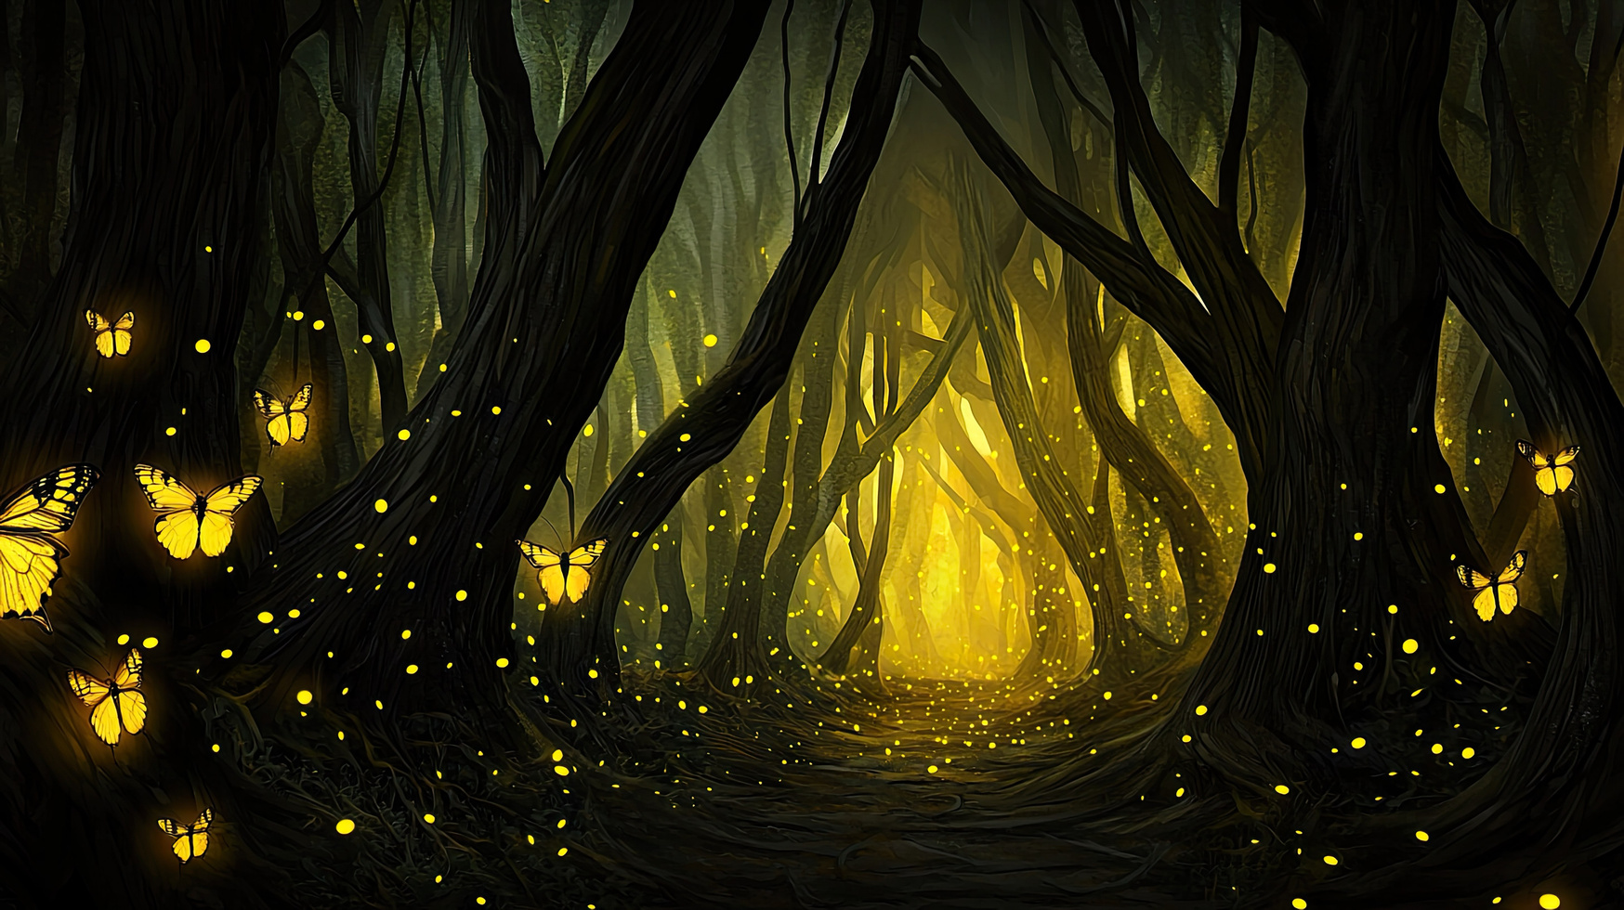
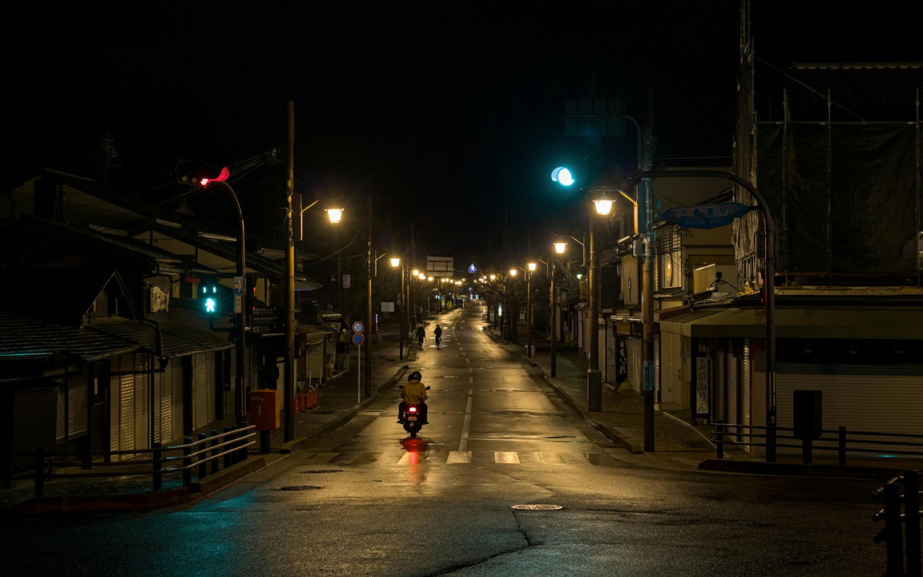
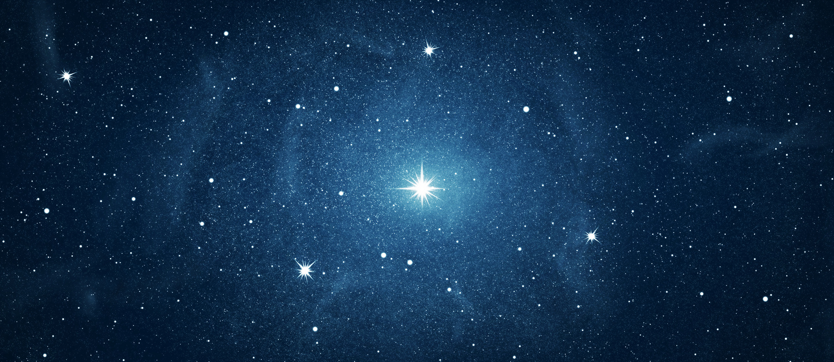
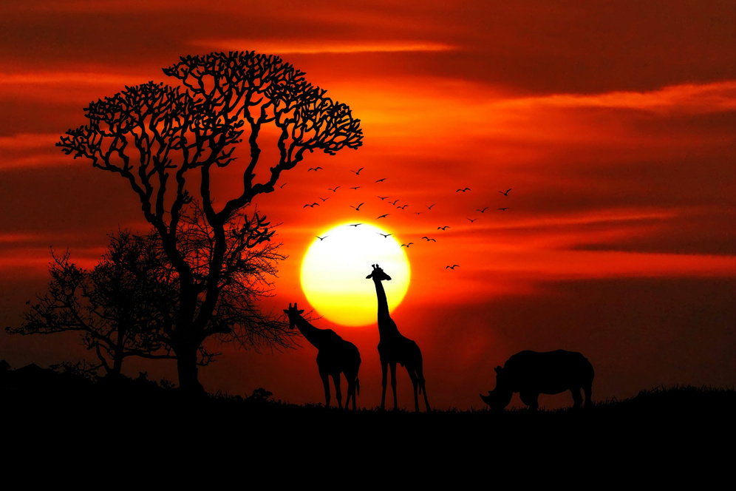
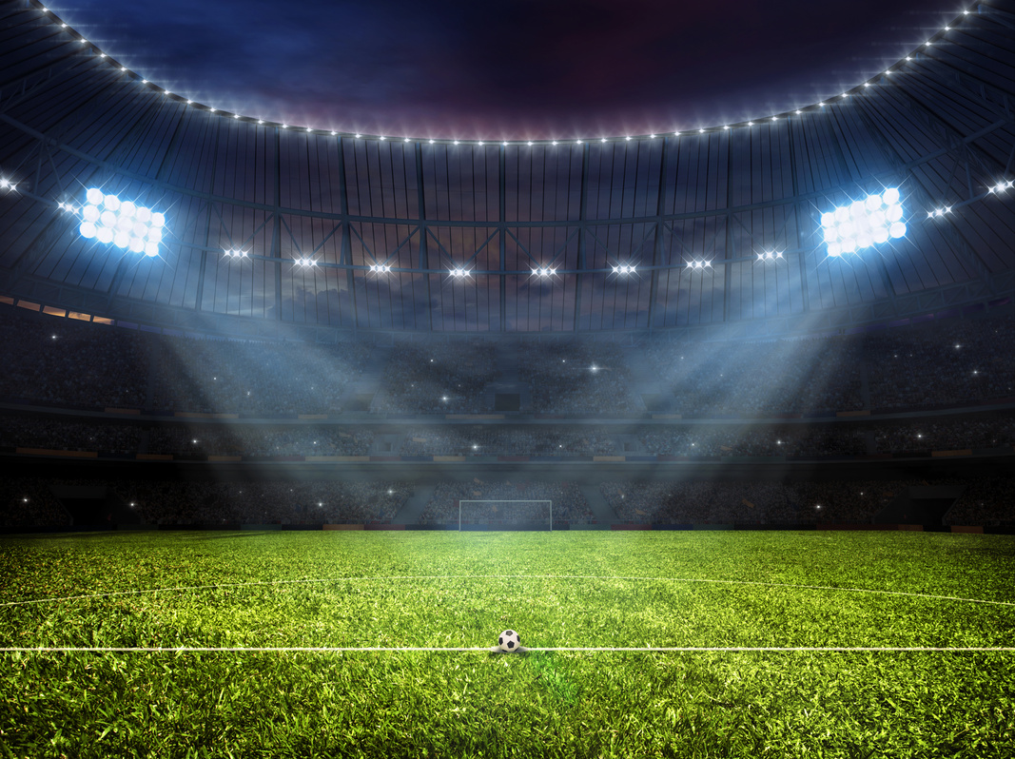
Image Bank
26
Junior
Young
Writers
Competition
Do any of these pictures spark your imagination?

Slide 8
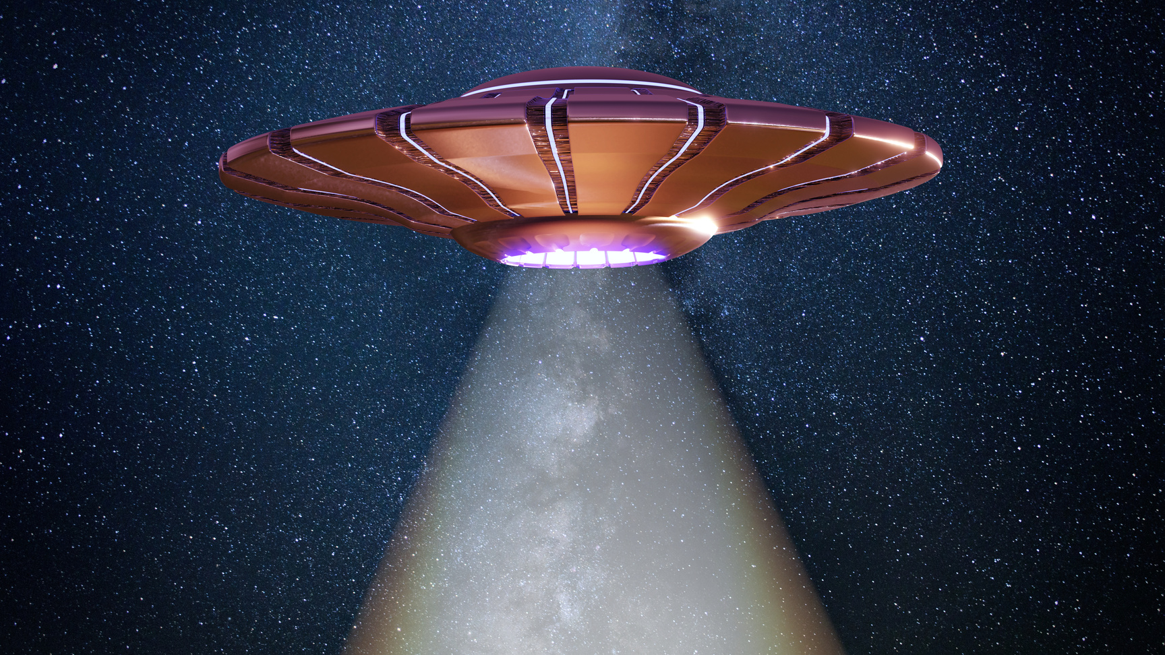

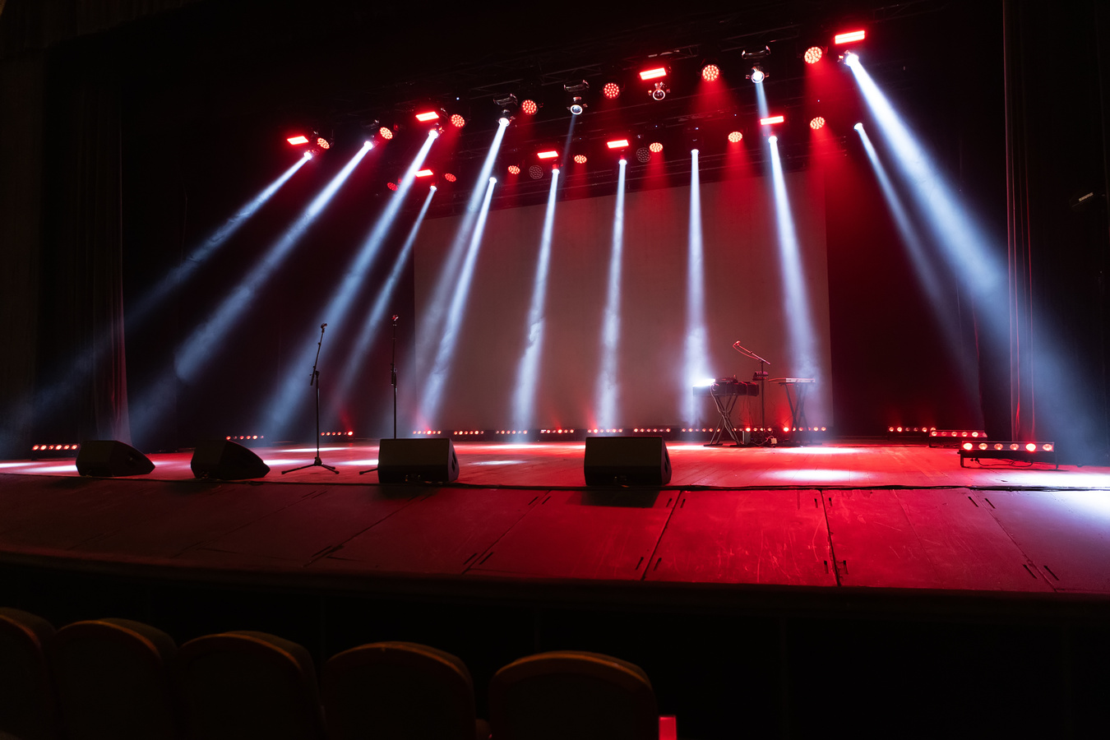
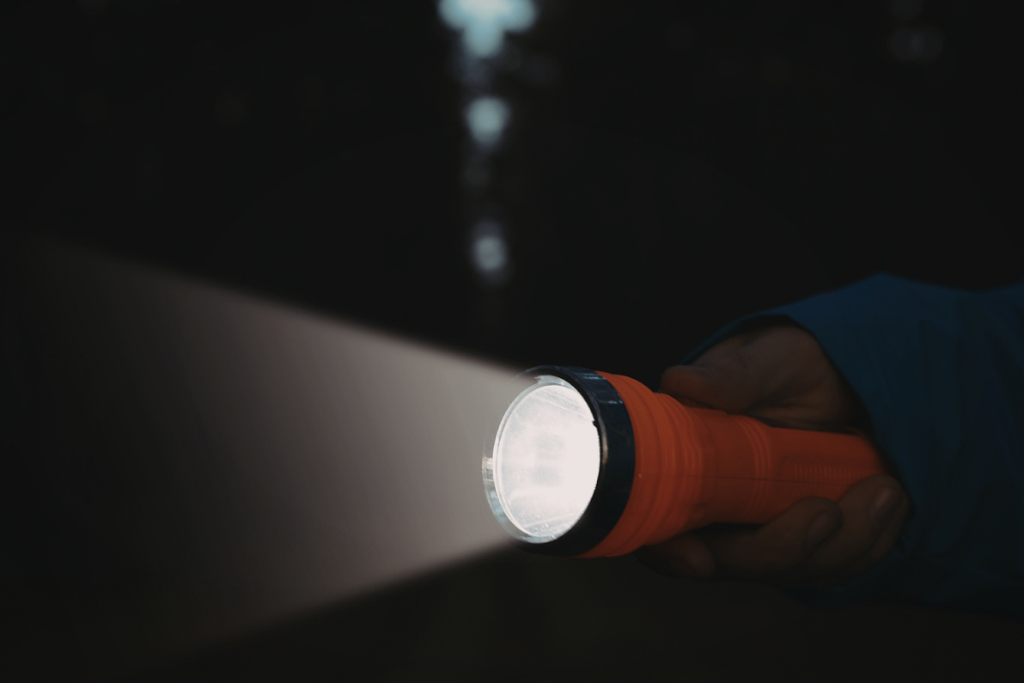
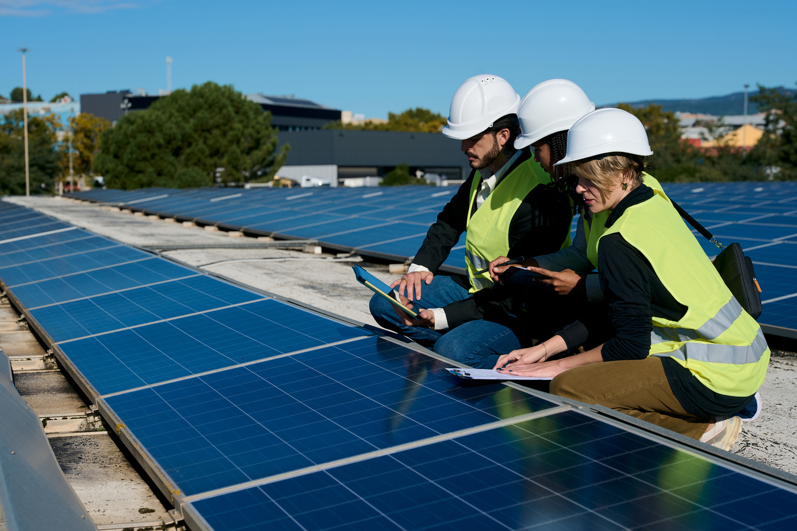
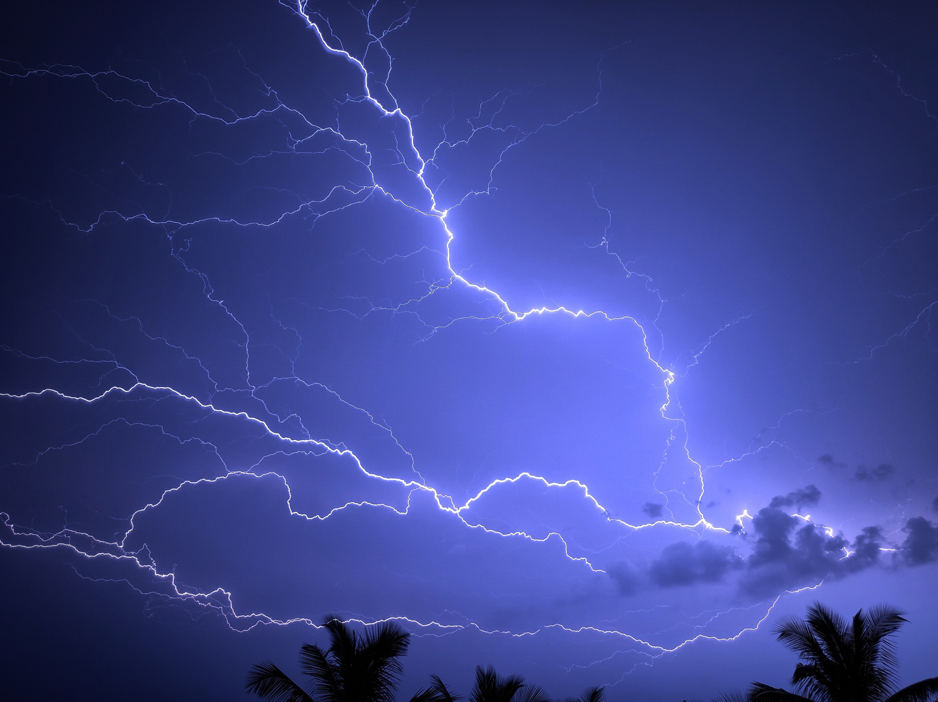
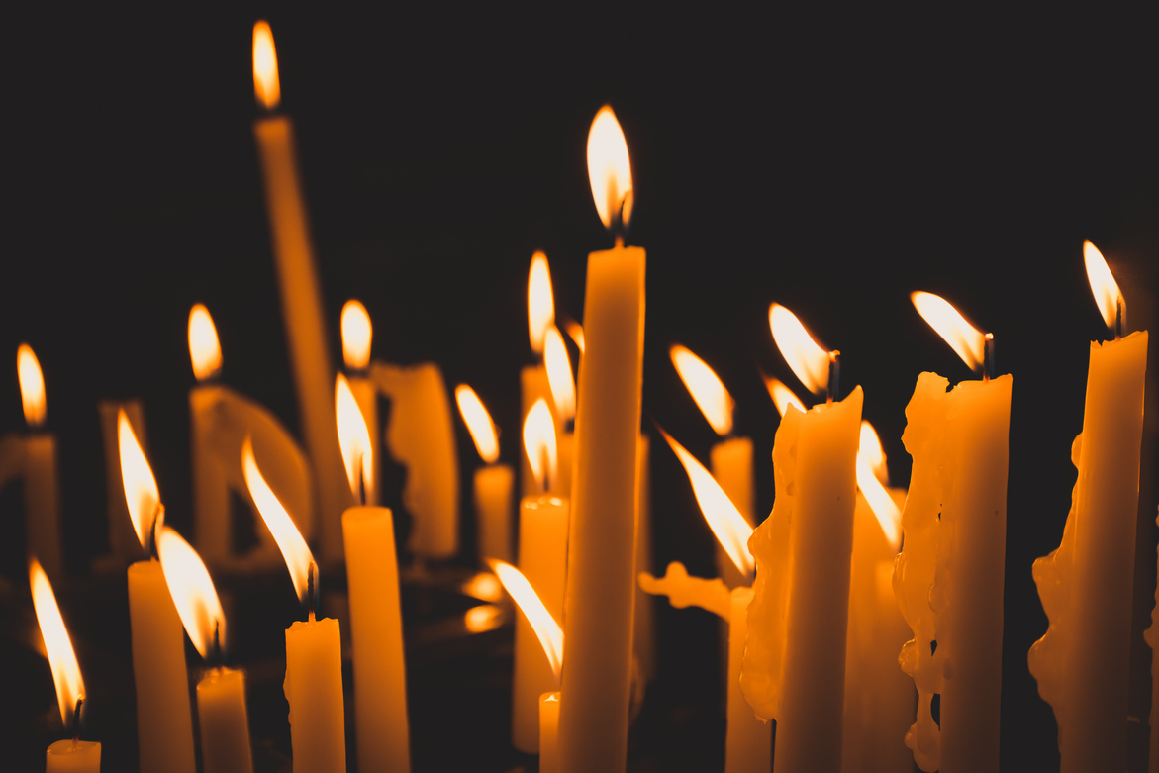
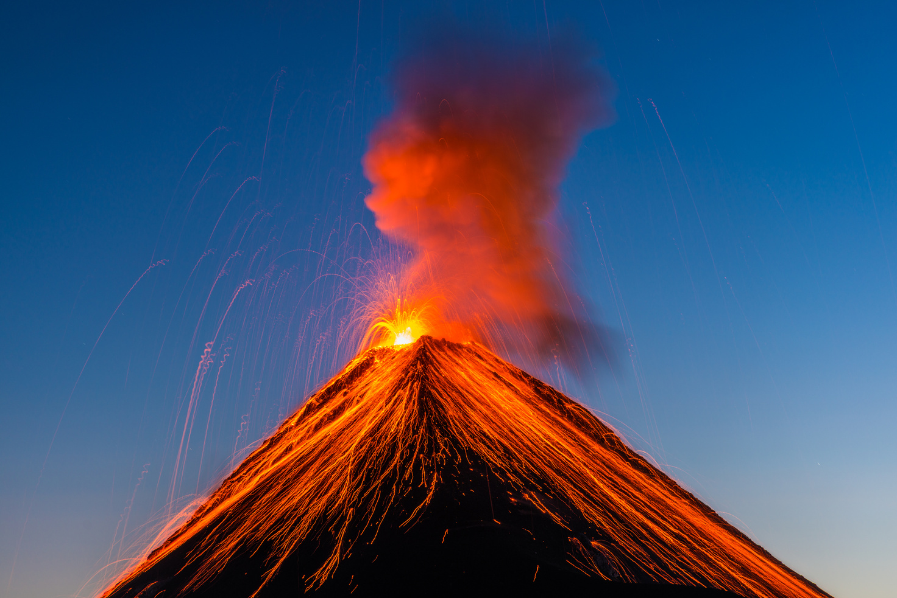
Image Bank
26
Junior
Young
Writers
Competition
Do any of these pictures spark your imagination?

Slide 9
Writing Prompts
26
Junior
Young
Writers
Competition
Lighthouse Guardian
Battle of Light and Dark
Lights in
the Sky
Into the Spotlight
The Star Keeper
Imagine you live in a lighthouse and it is your job to guide ships to safety. Write about a day in your life - who lives in the lighthouse with you, what do you do if a ship is in danger, what could go wrong?
Write a poem about an epic battle between glowing creatures of light and sneaky shadow beings. Why are they fighting, and who will be the ultimate winner?
Write about mysterious lights appearing in the sky. Is it a UFO, an asteroid or something else? What do the lights look like?
Why did they appear?
Write a story about a performer on a stage. They are under the spotlight. Are they a dancer, a singer, a comedian or even an actor? What will their performance be like? How does the audience react?
Write a story or a poem about a child who is specially chosen to look after a baby star. How do they keep it safe, and what happens when it starts to grow brighter and brighter?

Slide 10
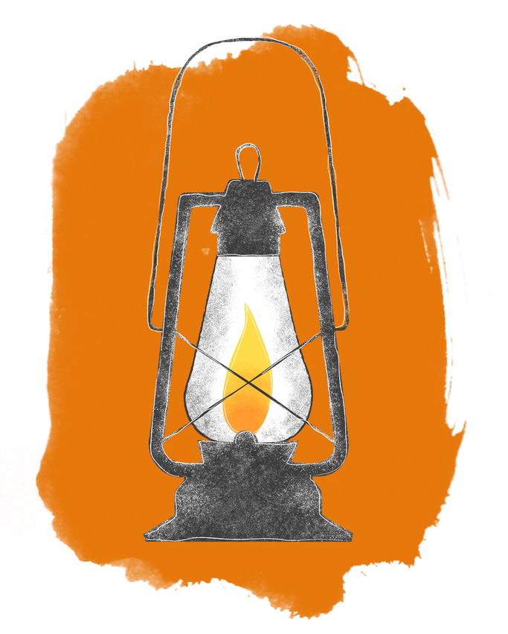
Writing Prompts
26
Junior
Young
Writers
Competition
Champion in the Spotlight
Changing Light
The Glowing Crystal
Light in our Lives
The Festival
of Light
Imagine you’re playing the biggest game of your life in a huge stadium lit by bright lights. The crowd is cheering, the lights are blazing - it is your moment to shine. How do you feel?
Write a poem about how the sun changes through the day, through the seasons, or even through the years. What about the phases of the moon?
Write a story about discovering a glowing crystal buried in your garden. What powers does its light have? What adventures begin when you pick it up?
Write a poem about what brings light and happiness to your life. It could be your friends or family, hobbies, music or something else entirely. Why is it important to you?
Write a poem about a festival that involves light - it can be real or imagined. What happens at the festival and what are they celebrating? Do people dress up or dance? What role do you play?

Slide 11
Story Starters
26
Junior
Young
Writers
Competition
I always thought the stories about the ‘Keeper of the Light’ were made up - until I became the next one.
She made a wish on the brightest star, and then something amazing happened…
The crowd cheered as the world-famous musician stepped into the spotlight.
He began to run as the fire grew larger and started to spread...
I switched on my torch, and the beam showed something I had never seen before…

Slide 12
Story Starters
26
Junior
Young
Writers
Competition
Everyone had heard of the Solar Warriors, who had the power of the sun. Now it was my turn to join them.
With only a flickering candle to guide him, he set off into the forest...
As their spaceship flew past the moon, they spotted something moving on its surface…
The glowing fairy landed on my hand and told me she needed my help…
She was no ordinary artist - she painted with beams of light!

Slide 13
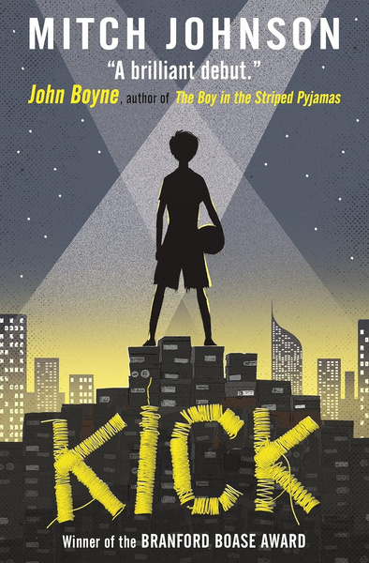
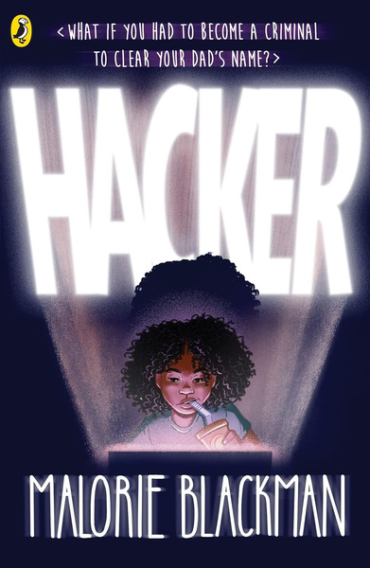
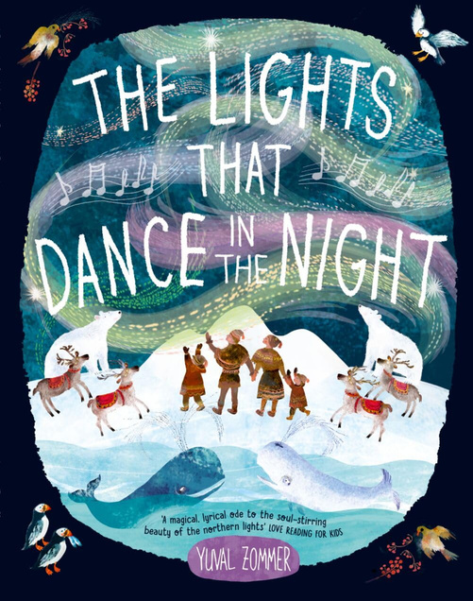
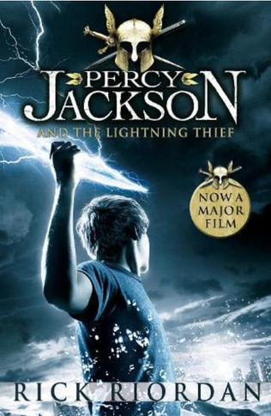
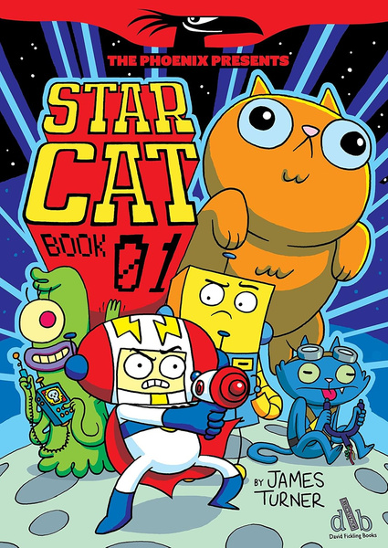

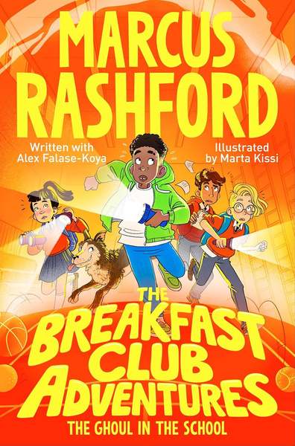
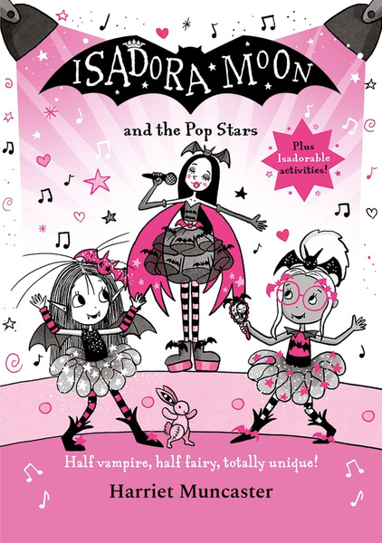
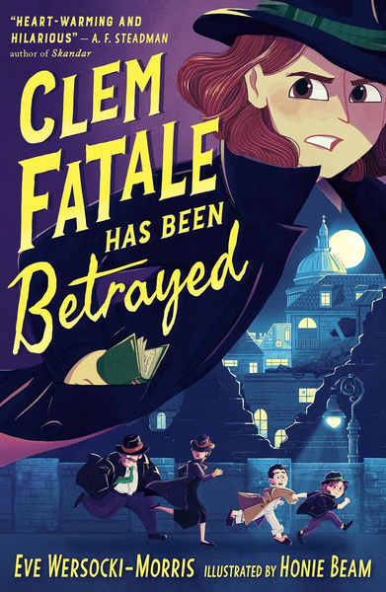
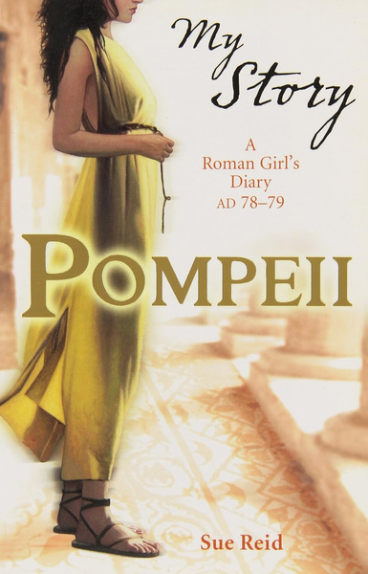
Reading Recommendations
26
Junior
Young
Writers
Competition
All the best writers are readers too! Use these books to find inspiration for your story or poem.

Slide 14
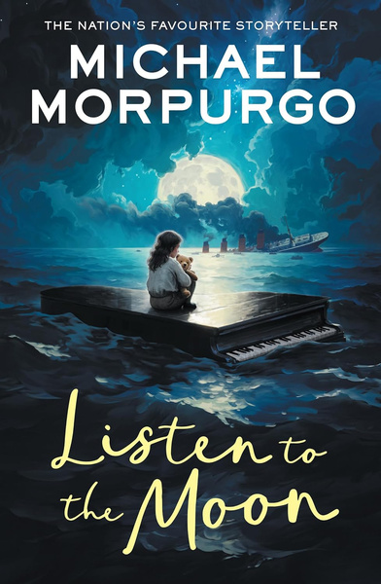
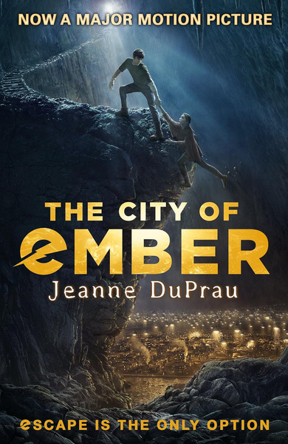
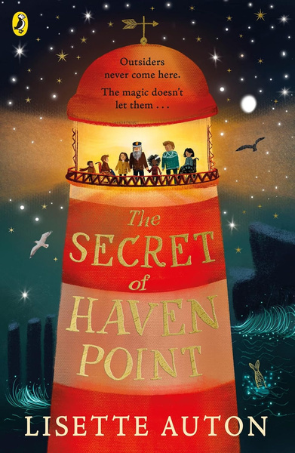
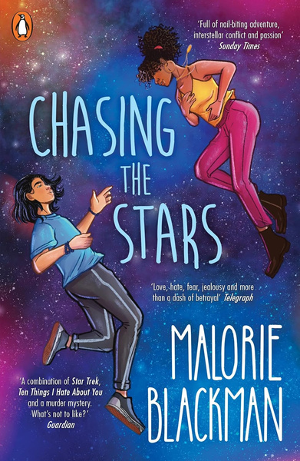
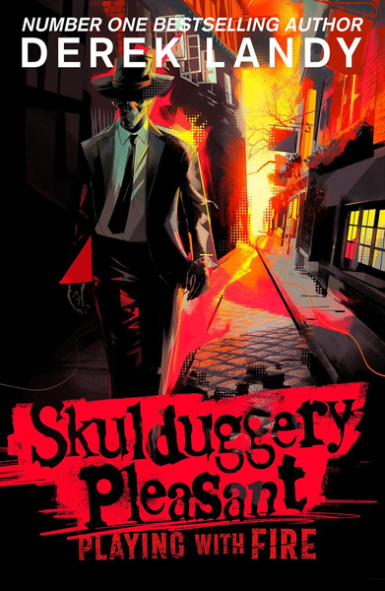
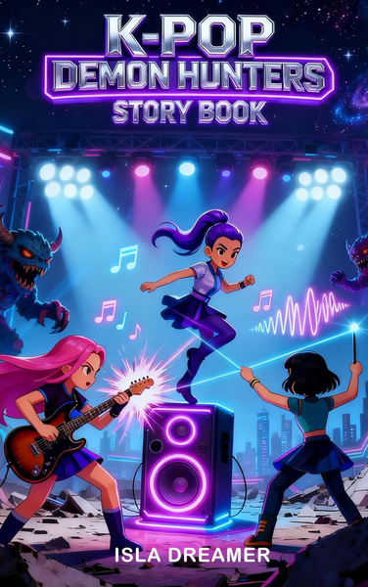
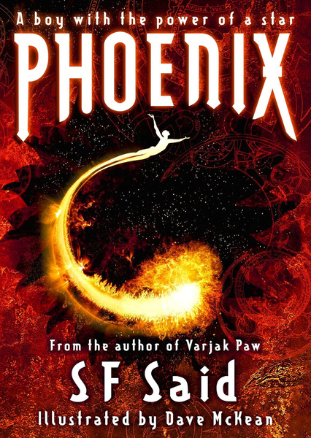
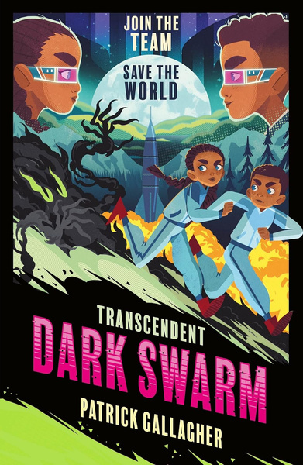
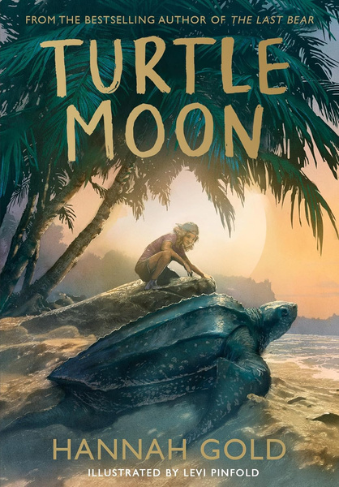
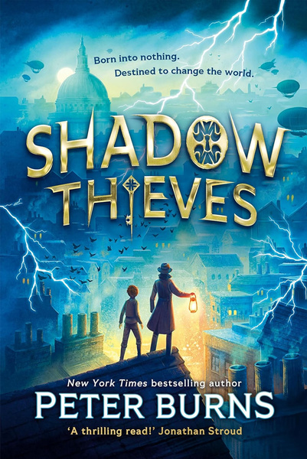
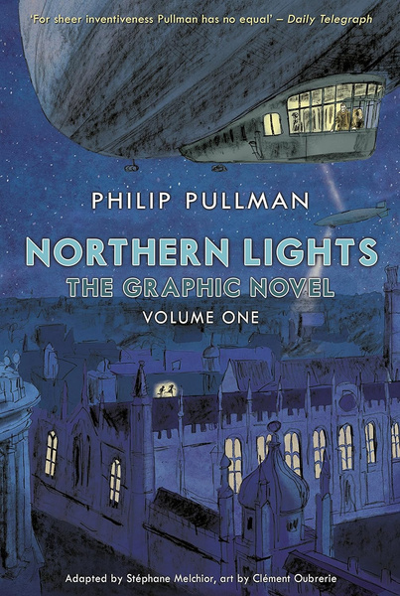
Reading Recommendations
26
Junior
Young
Writers
Competition
All the best writers are readers too! Use these books to find inspiration for your story or poem.

