Slide 1
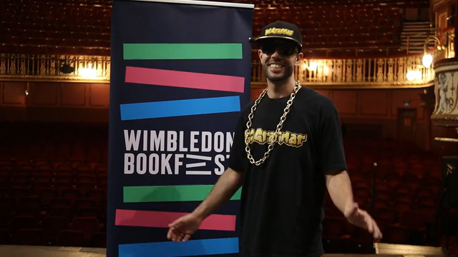

Slide 2


26
Senior
Young
Writers
Competition
This year, we are inspired by the sources that brighten our world and our theme is:
The Light

Slide 3
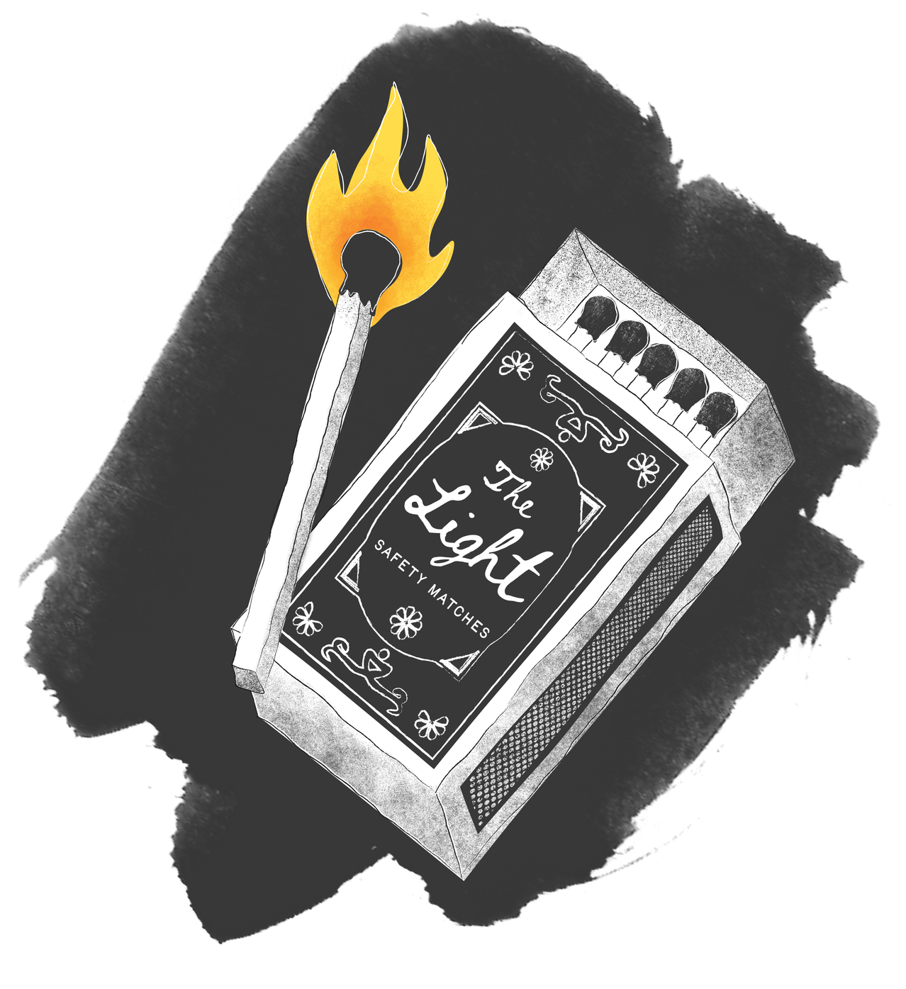
The Light
26
Senior
Young
Writers
Competition
Light exists all around us. It can be natural: the sun, moon and stars, lightning splitting the clouds, or a single candle flickering in the dark.
You might think about artificial light: a screen glowing in the dark, streetlights guiding you home, LEDs blinking on a machine or lights of a fairground. You could start your story with a single beam of light in darkness.
Do these lights help us see clearer or do they expose us? Are they beautiful or blinding, do they bring hope and guidance, or surveillance and danger?

Slide 4

The Light
26
Senior
Young
Writers
Competition
Perhaps it is a lighthouse standing alone in a storm, a spotlight on a stage, floodlights of a stadium, or even the lights of a UFO.
Are these lights magical or mythical? Have the lights always existed, or did they arrive mysteriously or suddenly?
Lights can be an event or celebration, from the candles of Diwali to the fireworks of Guy Fawkes Night. Could you write about a celebration you know, or invent your own festival of light? You could even write about when there is no light or think about what light could represent.

Slide 5

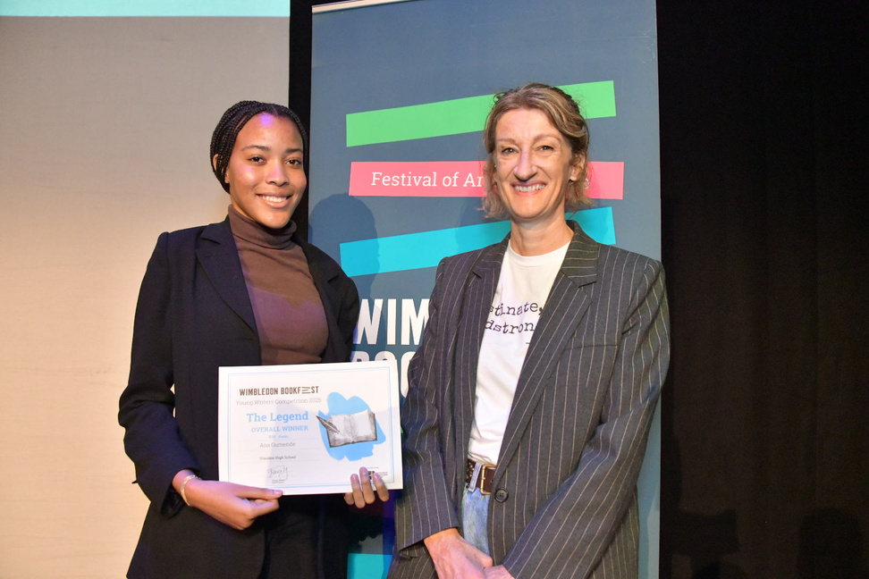
Prizes
26
Senior
Young
Writers
Competition
Every student that is selected by their school will receive a certificate.
Winners, Runners Up and Entrants that receive Distinctions will have their work published in the 2026 Wimbledon BookFest Anthology.
Winners and Runners Up will be invited to our Prize-Giving event at the New Wimbledon Theatre to receive their certificate and a copy of the anthology
One lucky overall competition winner will win an iPad!

Slide 6
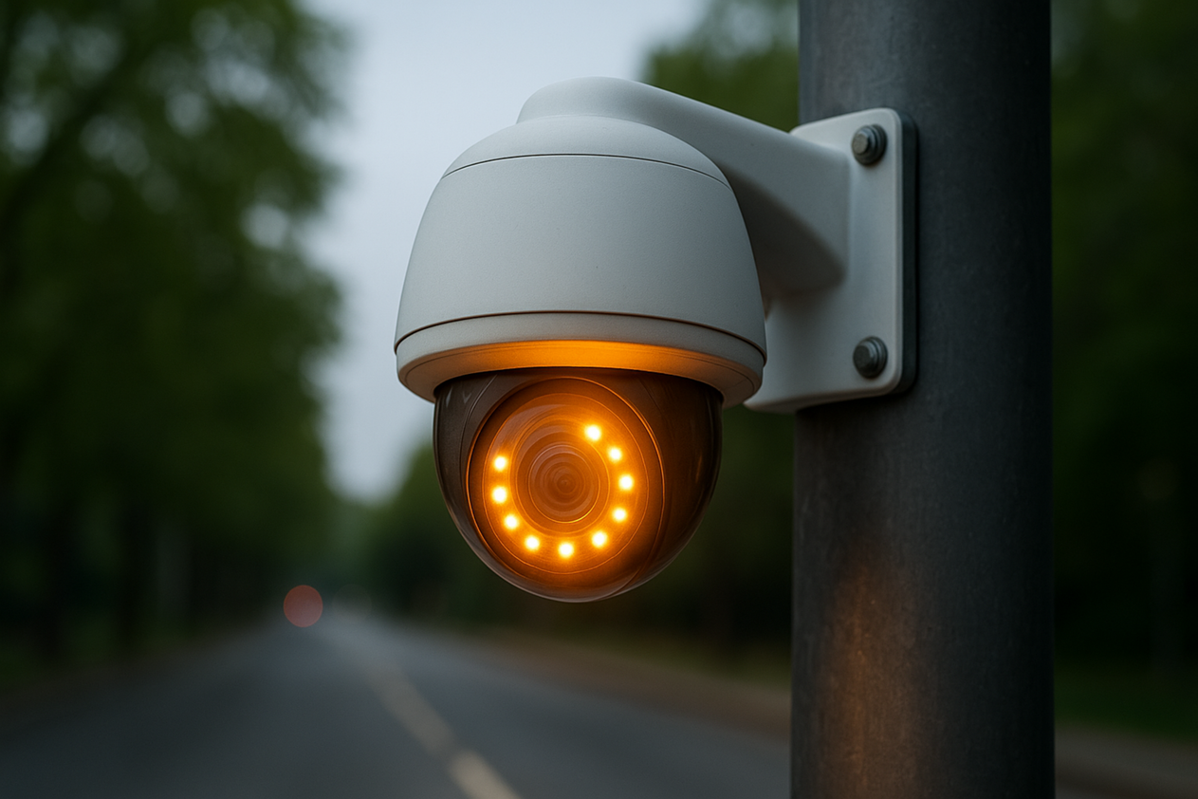

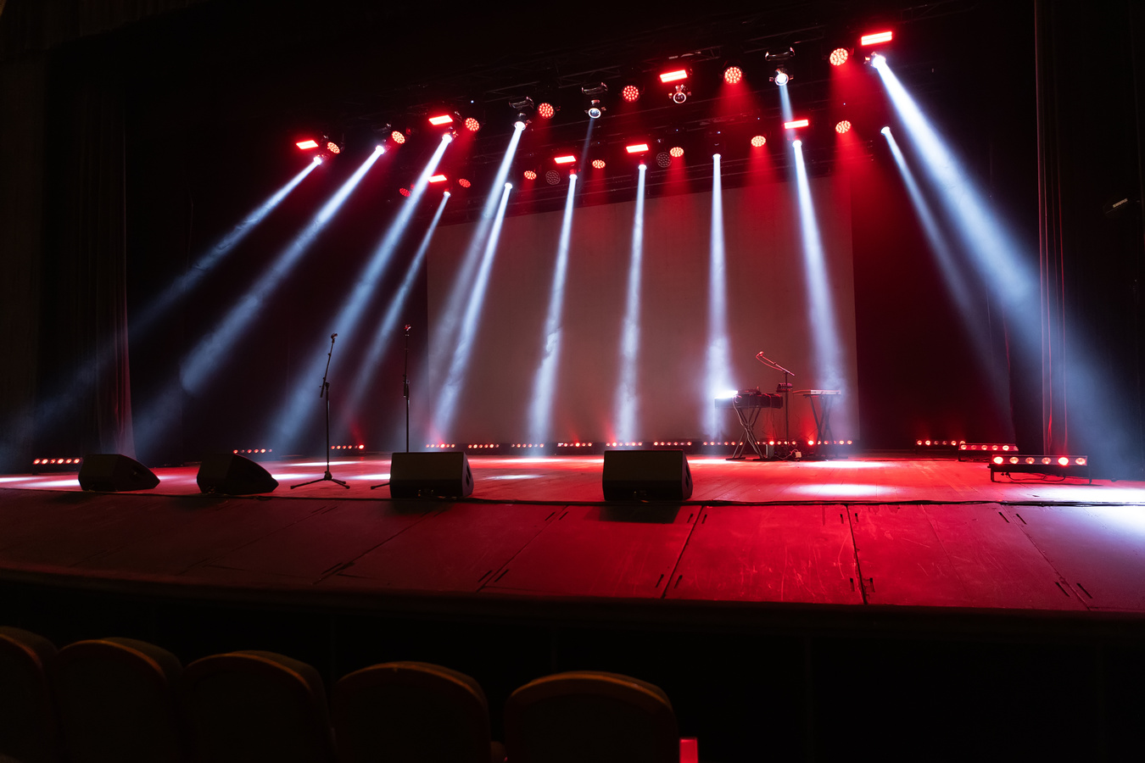
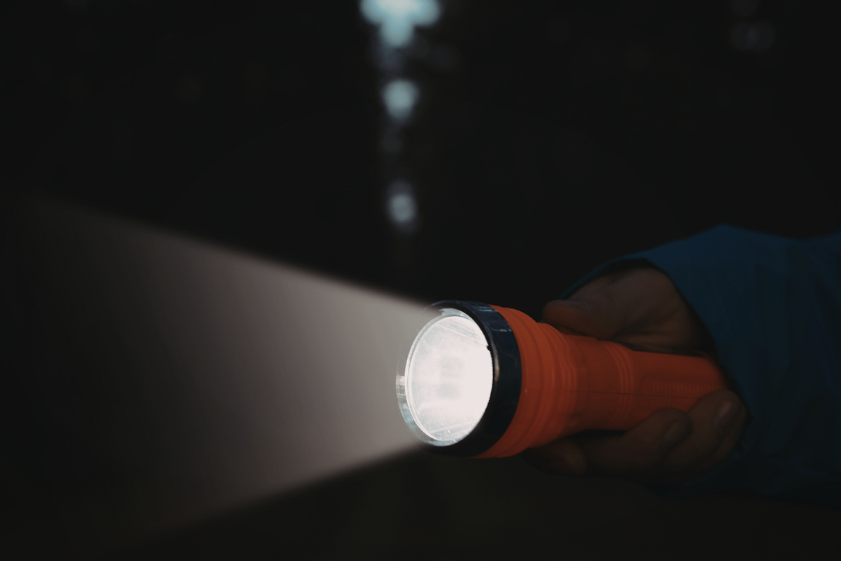

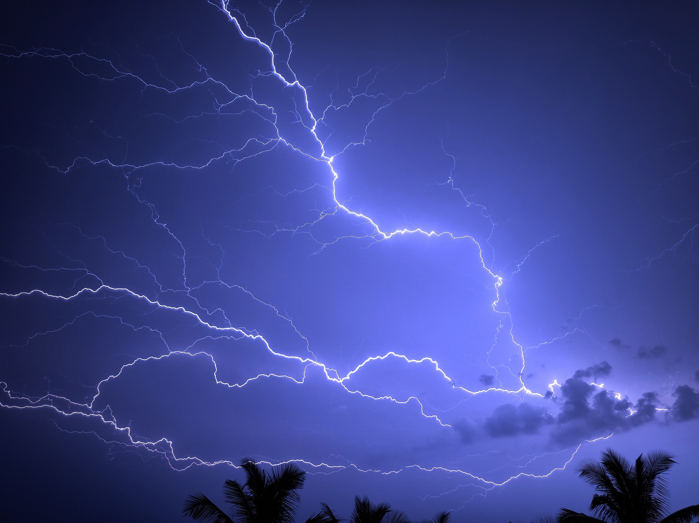
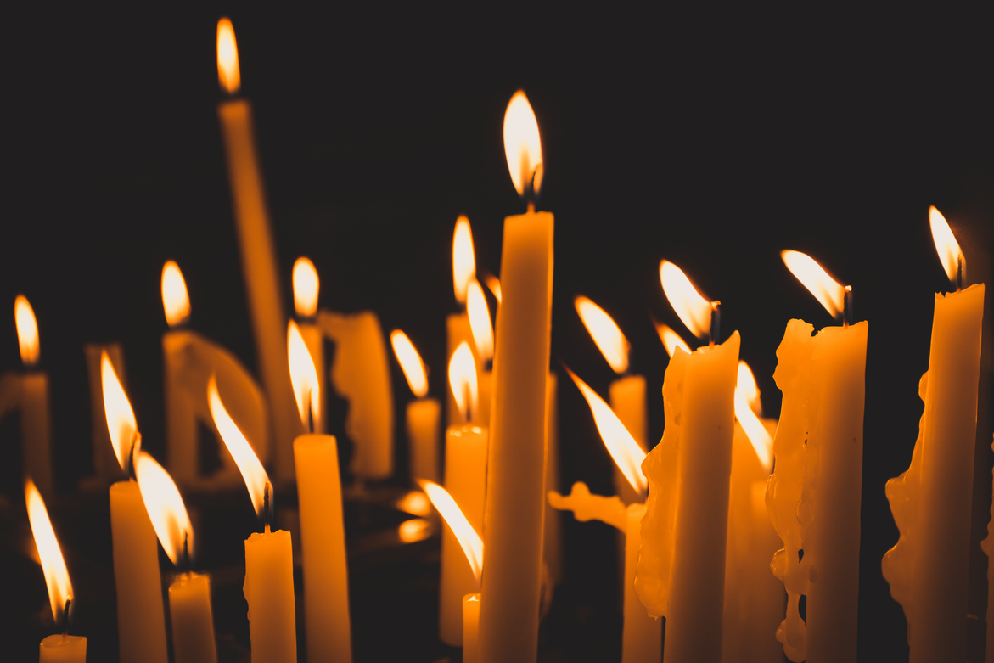
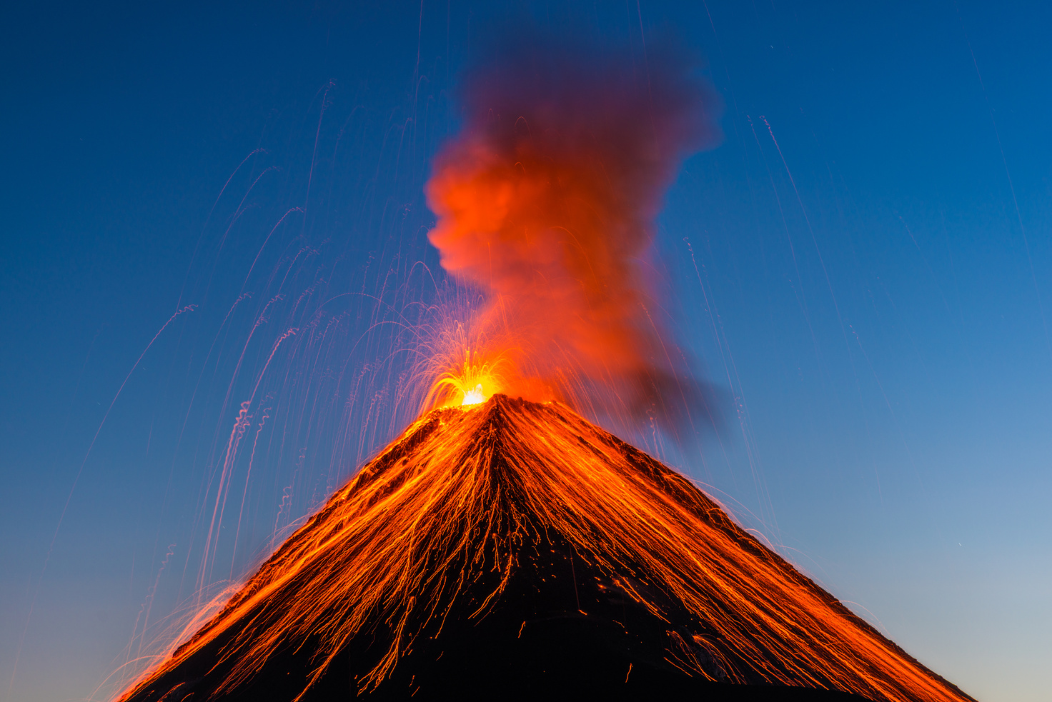
Image Bank
26
Senior
Young
Writers
Competition
Do any of these pictures spark your imagination?

Slide 7
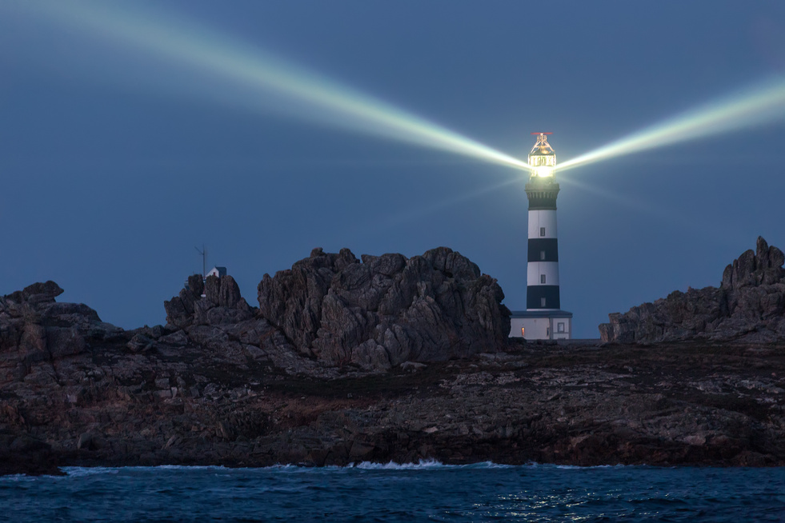

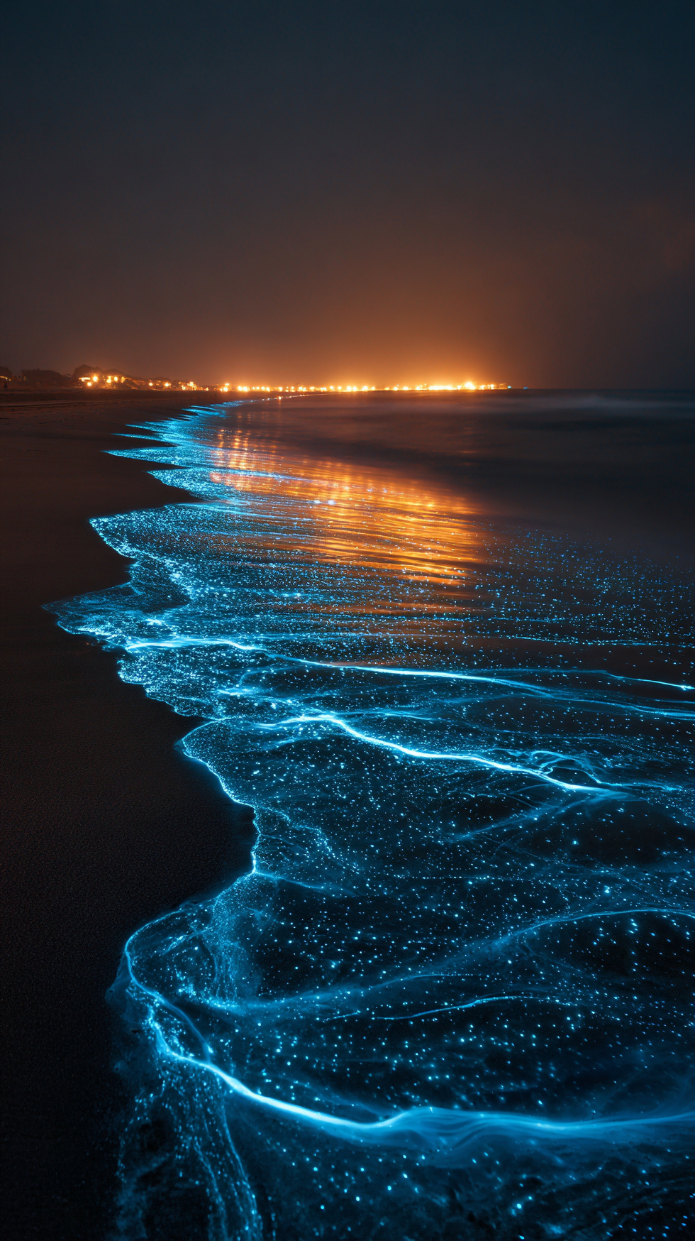
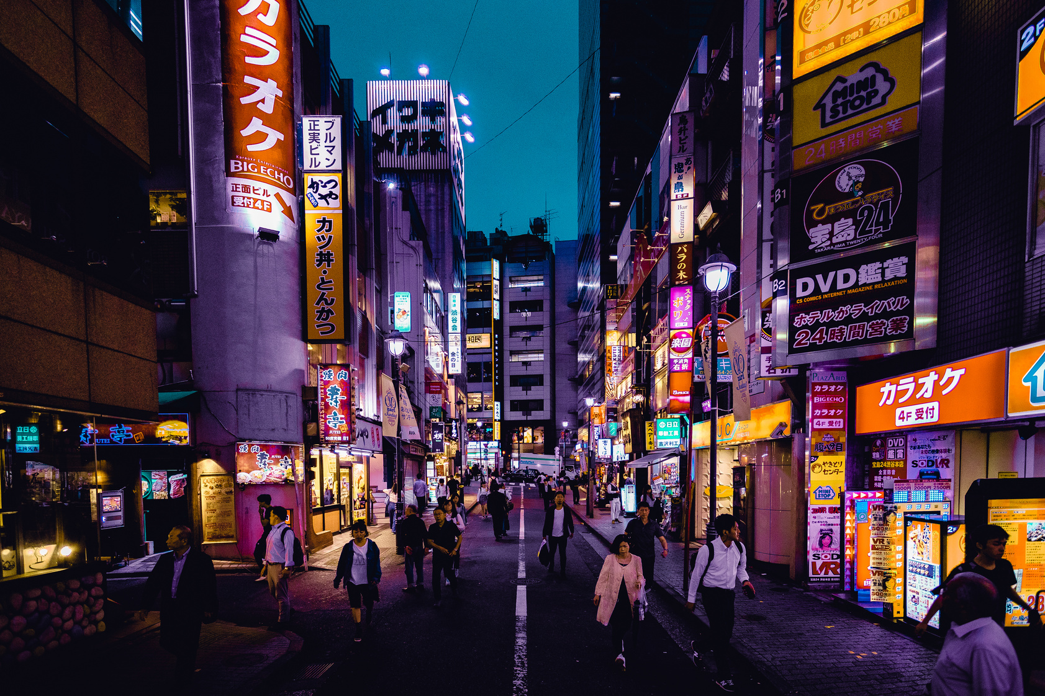
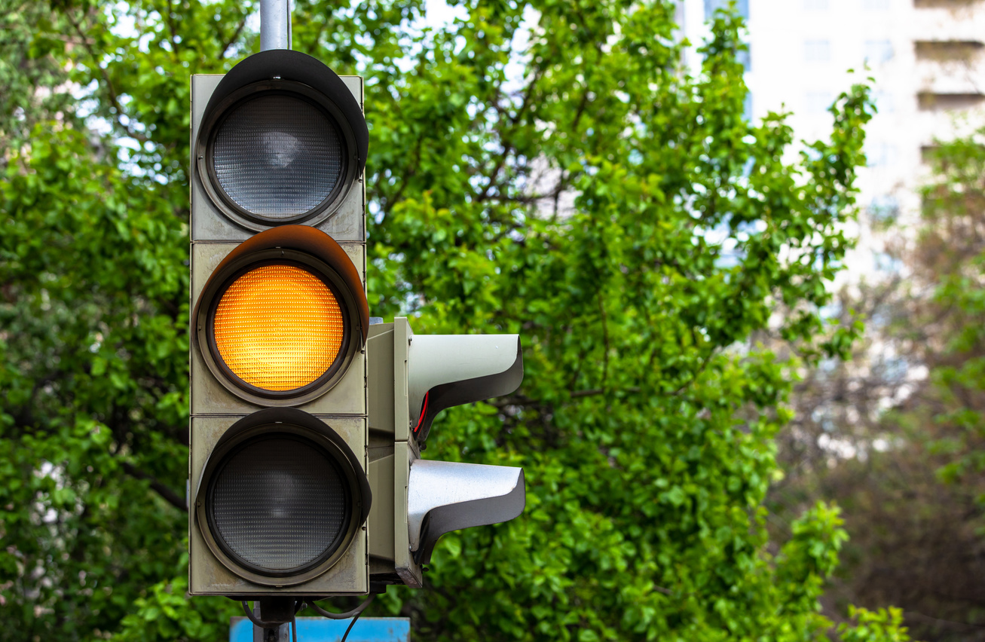
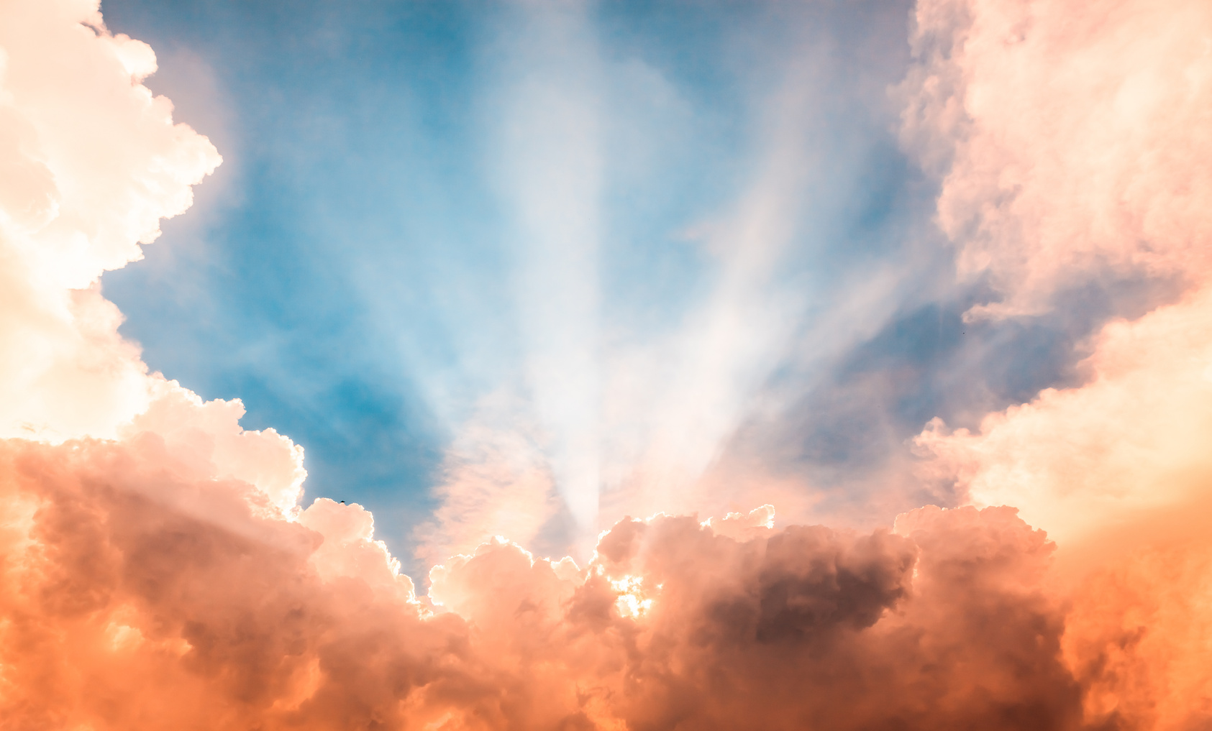
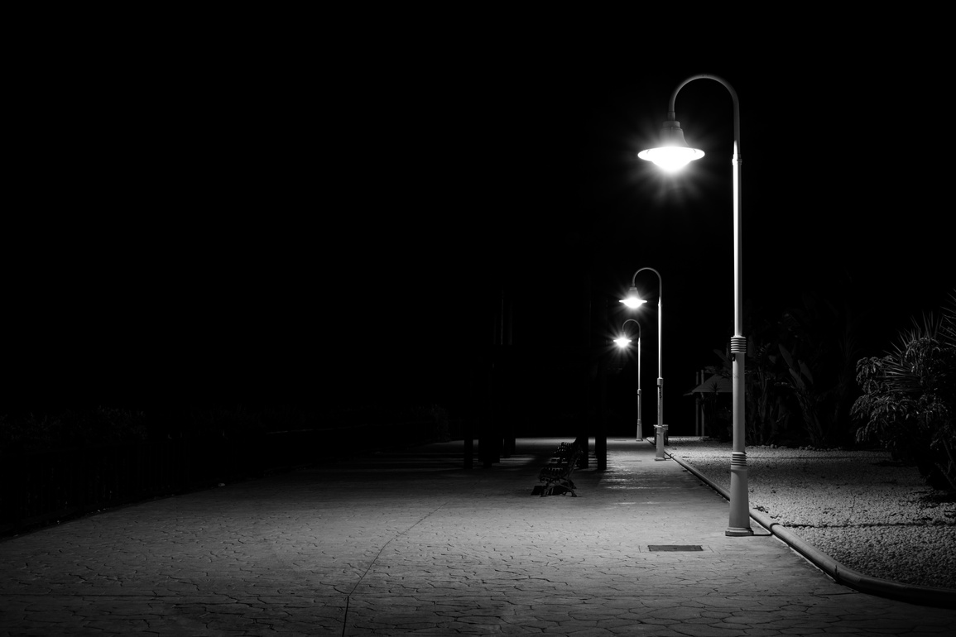
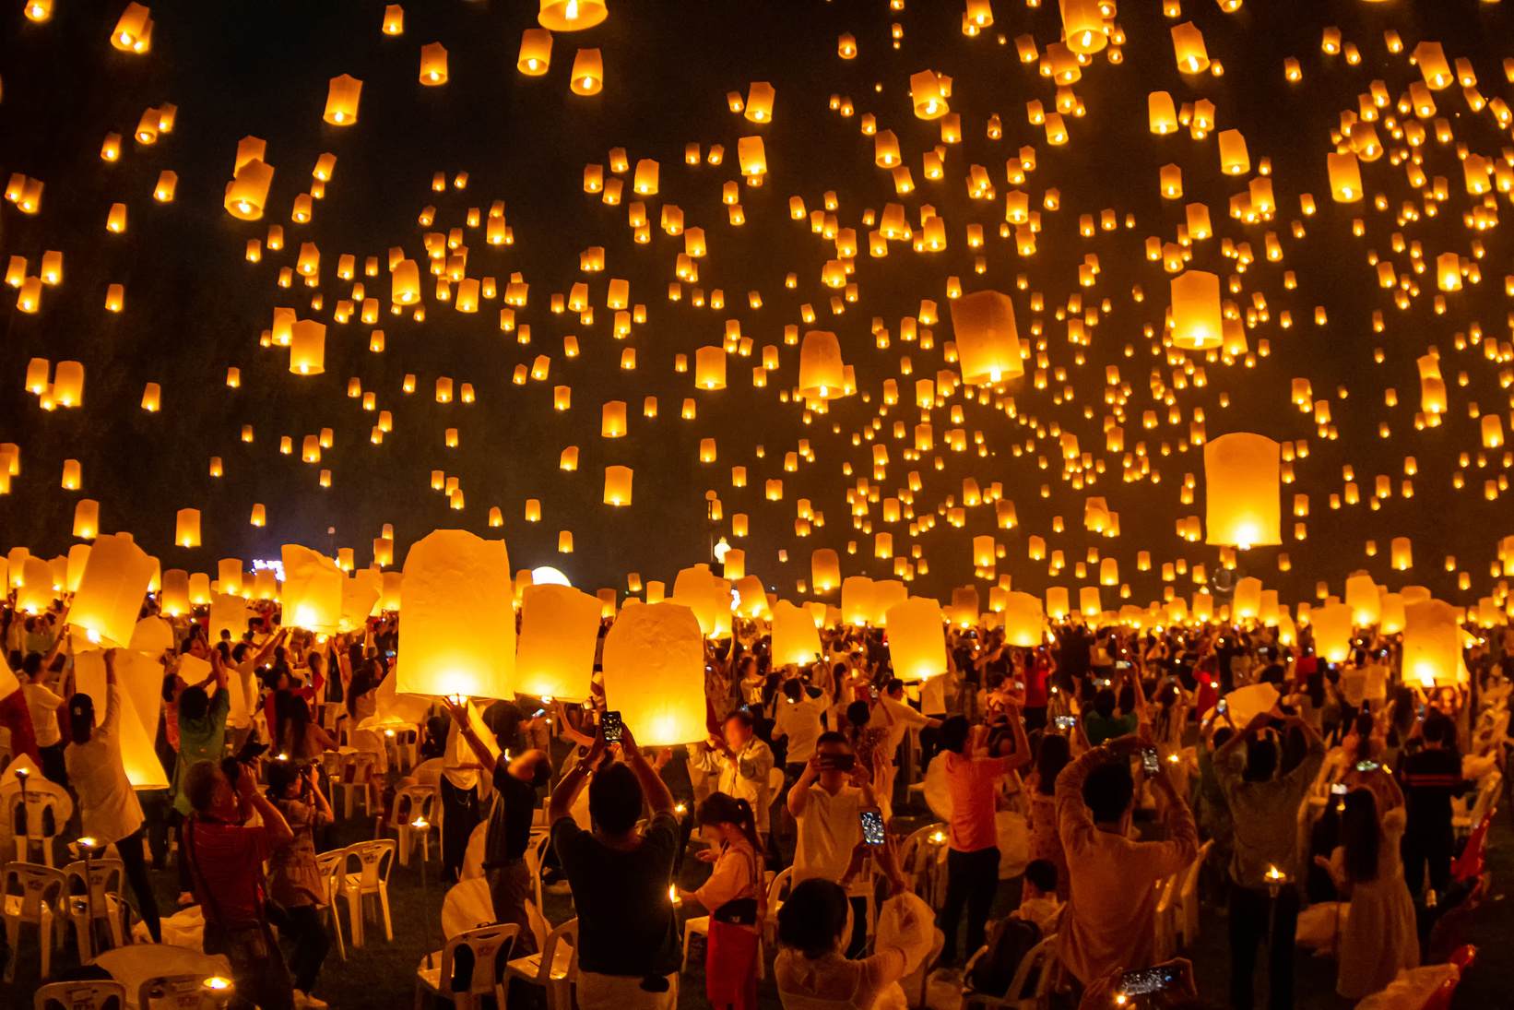
Image Bank
26
Senior
Young
Writers
Competition
Do any of these pictures spark your imagination?

Slide 8
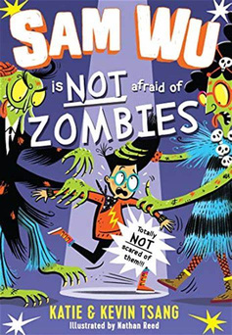
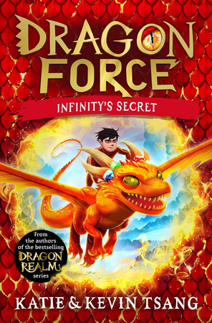
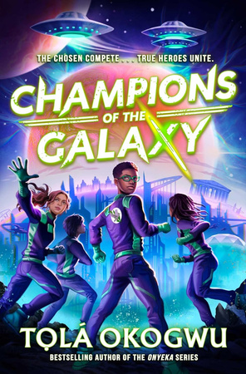
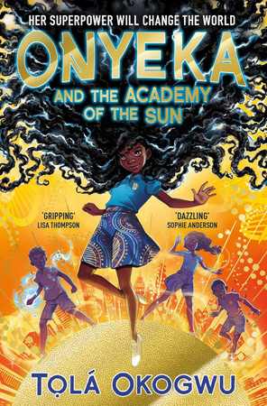
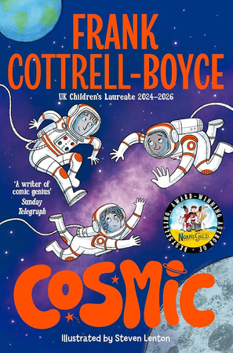
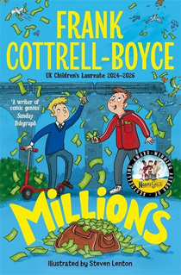
Writing Tips
26
Junior
Young
Writers
Competition
Here are some writing tips from bestselling and award-winning authors!
Write YOUR story
Don’t be scared of a messy first draft
Just start writing!
“Write what excites you and it will come across on the page.”
Kevin & Katie Tsang advise writers to think about what you love and use that as the inspiration - your favourite stories, your hobbies, your friends and family – anything you feel passionate about.
Children’s Laureate Frank Cottrell-Boyce says, “Don’t worry about having a perfect idea before begin - just start writing and ideas will come!”
Even if you don’t have the perfect idea, writing will help to get your imagination going.
Tọlá Okogwu says not to worry about getting the perfect story first time.
“First drafts are supposed to be messy! No one is going to see it but you. Just get all your ideas on the page - you can edit and find the perfect words later.”

Slide 9
Writing Prompts
26
Senior
Young
Writers
Competition
Champion in the Spotlight
The Glow from the Forest
Lights in
the Sky
The Message on the Screen
Solar Power
Imagine you’re playing the biggest game of your life in a huge stadium lit by bright stadium lights. The crowd is cheering, the lights are blazing - it is your moment to shine. How do you feel?
Write a story about suddenly seeing glowing lights in the darkness of a huge forest. Do you follow them? What do you discover? If there is danger, how do you escape?
Mysterious lights appear in the sky and nobody can explain where they came from. Is it an asteroid, or a UFO, or something else?
Why did they appear?
A computer screen lights up at night, showing a coded message. Write a story about someone who sees the message - what does it say and what happens after they read it?
There is a secret society of people who can harness the power of light - of the moon, the stars and even the sun. You are invited to join. Write about your first day, training or even your first battle.

Slide 10
Writing Prompts
26
Senior
Young
Writers
Competition
Changing Light
The Tale of
the Light
Artificial Sunlight
Light in our Lives
In the Darkness
Write a poem about how the sun changes through the day, through the seasons, or even through the years. What about the phases of the moon, of the lifecycle of a star?
Write a poem or story about a tale passed down through the generations about ‘The Light’.
What is it? Is it a warning, or a story of celebration?
Long ago, the sun disappeared and now the people of Earth live in a world of artificial light. How life is different and what changes? Does anyone try to bring back the sun?
Write a poem about what brings light to your life. It could be your friends or family, hobbies, music or something else entirely. Why is it important to you?
Think about places we associate with darkness - caves, the bottom of the sea, deep forests and the dead of night. Does light exist there? What could it look like?

Slide 11
Story Starters
26
Senior
Young
Writers
Competition
1. I always thought the stories about the ‘Keeper of the Light’ were made up— until I became the next one.
2. It was ultimate battle, the final showdown between the Lights and the Shadows.
3. The band knew it was their only shot to make it big. As the lights go down in the stadium, they began to play.
4. As the waves rose and the rain poured down, I knew our only hope was the lighthouse in the distance.
5. We were nearly there, running through the dark city. All of sudden, a spotlight blinded us and alarm sounded. We had been spotted.

Slide 12
Story Starters
26
Senior
Young
Writers
Competition
6. The city had been abandoned, dark and empty for as long as I could remember. Until today, when a window on the highest floor of a skyscraper lit up.
7. Every year, the village celebrated the return of the sun and the start of summer with the Festival of Light.
8. Our parents always told us that the glowing lights in the forests were fairies and spirits. I wanted to know the truth.
9. As their spaceship flew past the moon, they spotted something moving on its surface…
10. In the dark and mysterious maze, the explorers only had the light of a flickering lantern to guide them...

Slide 13
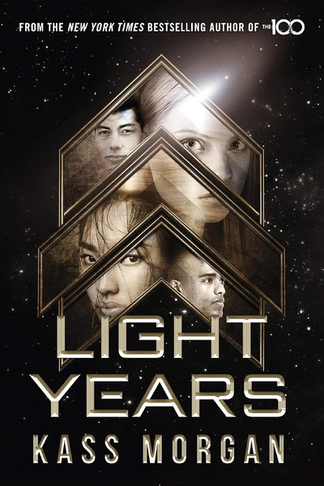
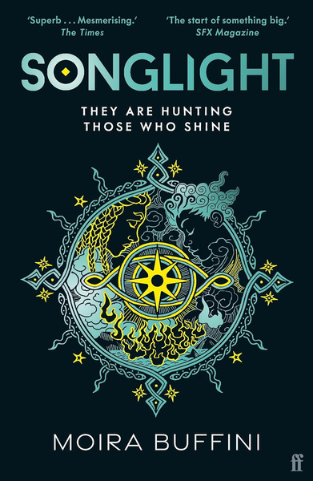
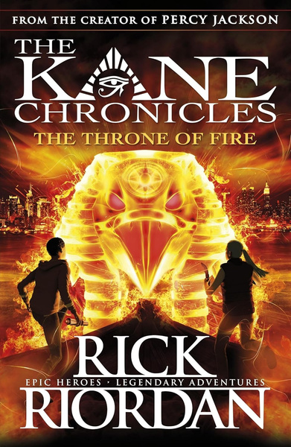

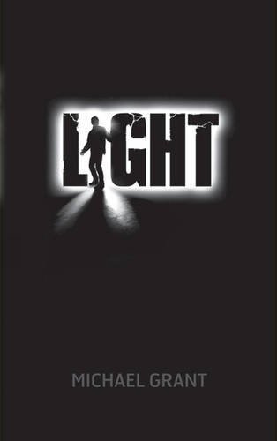
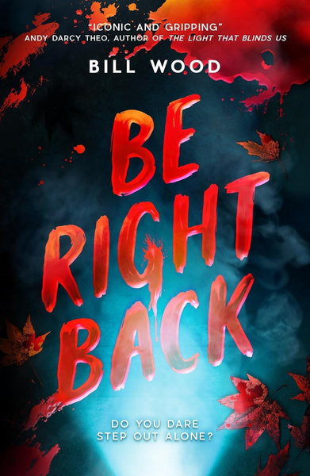
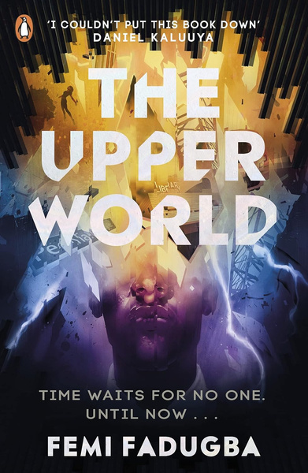
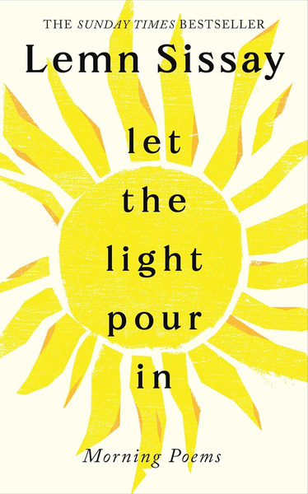
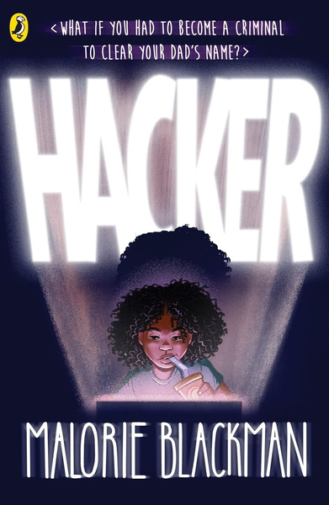

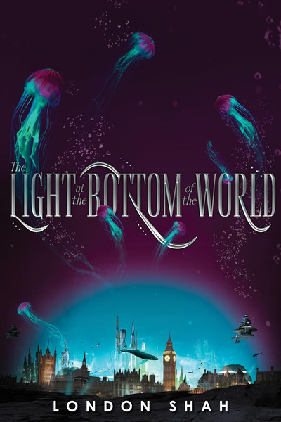
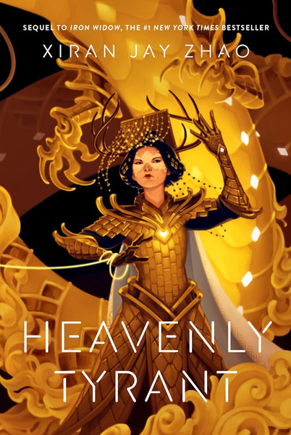
Reading Recommendations
26
Senior
Young
Writers
Competition
Senior
All the best writers are readers too! Use these books to find inspiration for your story or poem.

Slide 14
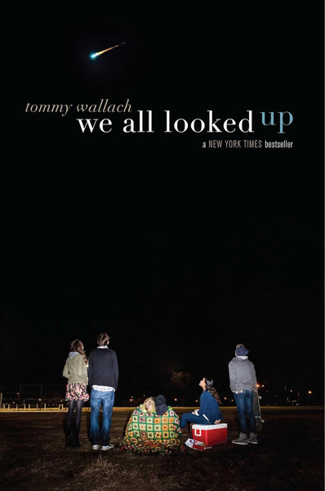
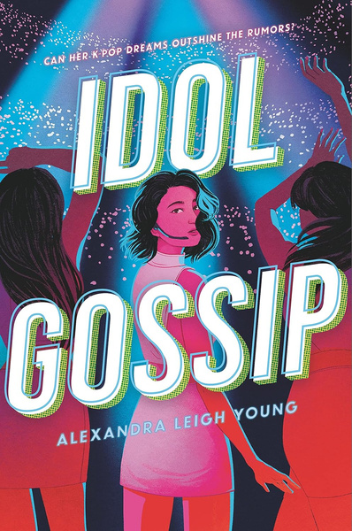
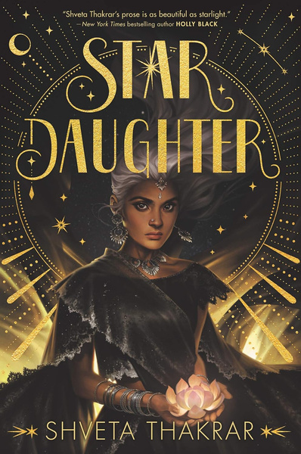
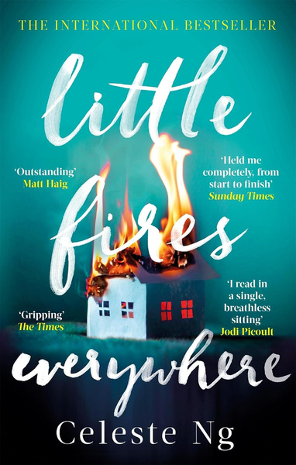
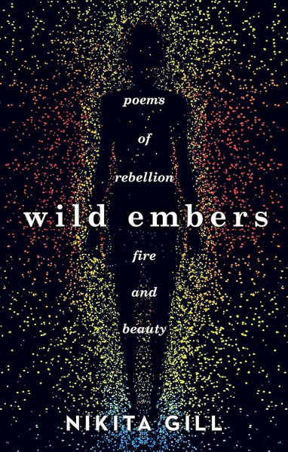
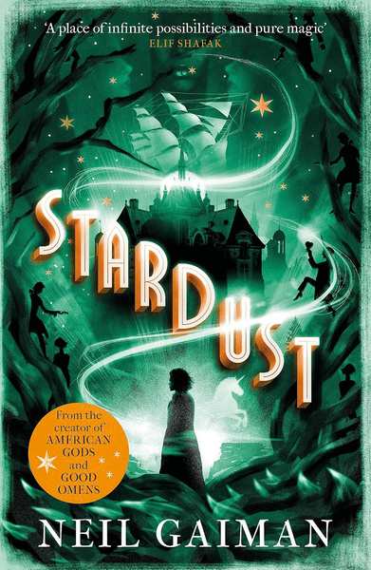
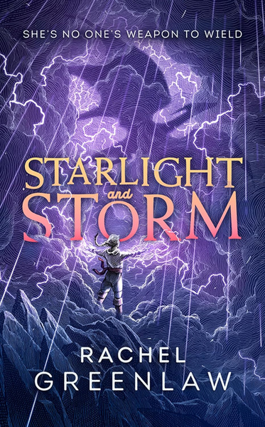
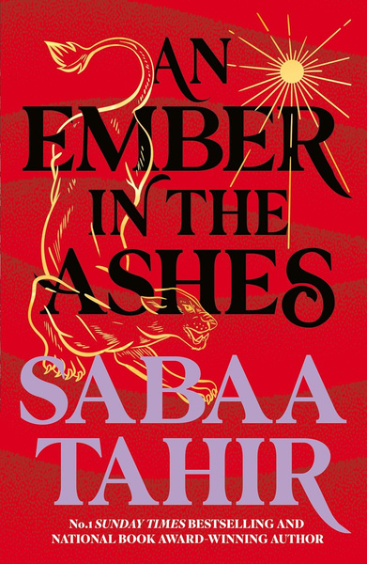

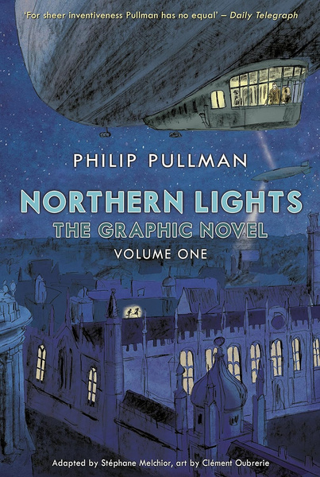
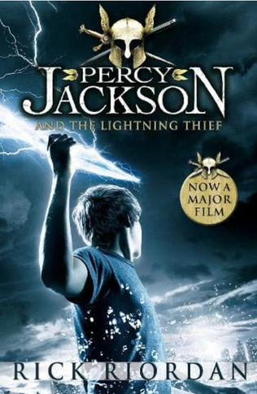
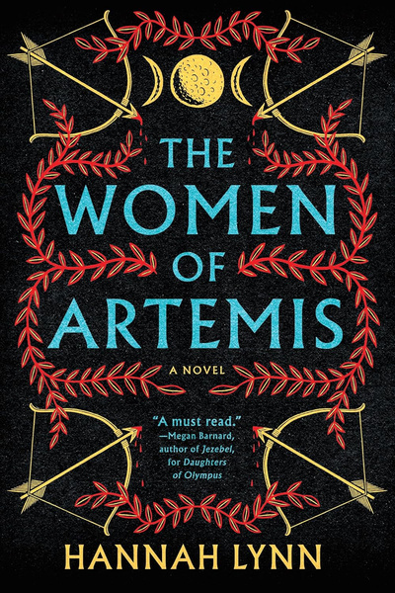
Reading Recommendations
26
Senior
Young
Writers
Competition
Senior
All the best writers are readers too! Use these books to find inspiration for your story or poem.

