Slide 1
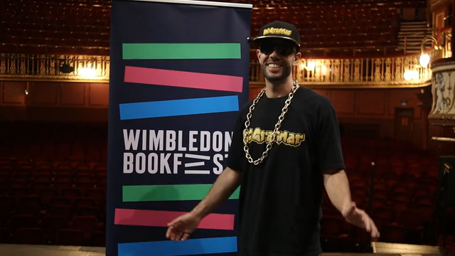

Slide 2

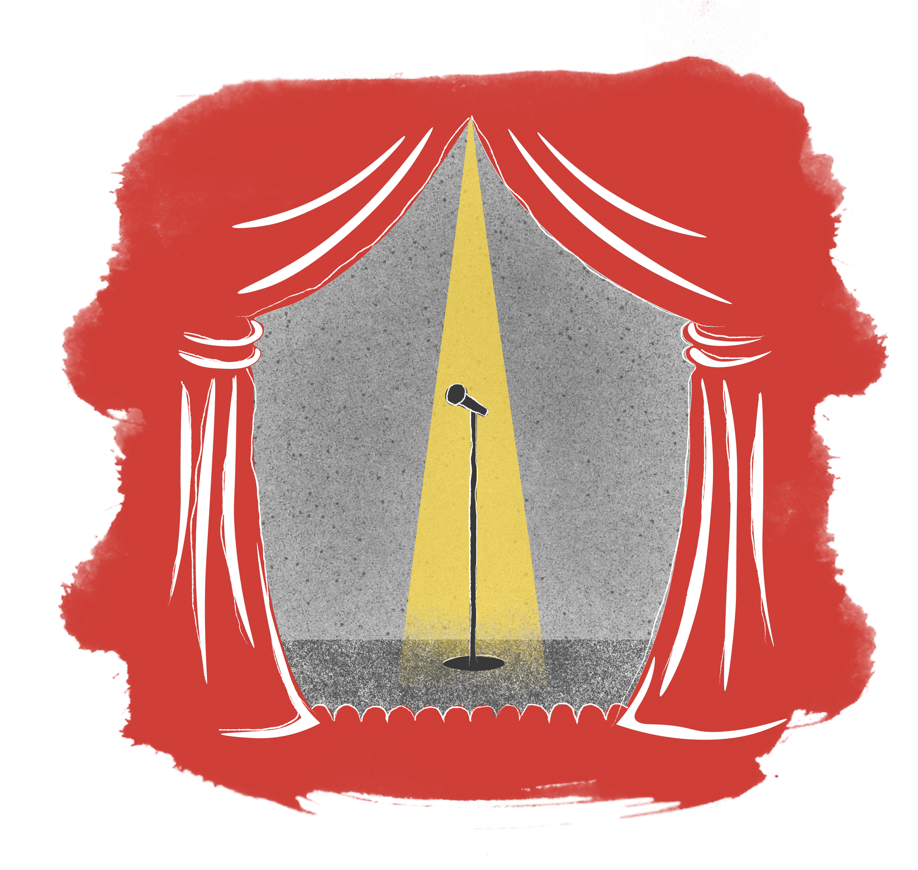

The Light
26
SEN
Young
Writers
Competition
Light exists all around us: the Sun, the Moon and Stars.
You could also write about fireworks, a lighthouse, a UFO or the magical light of fairies.
Your story could be about the spotlights on a stage or the floodlights of a football stadium.
We also have lights for festivals and celebrations like Christmas or Diwali.

Slide 3

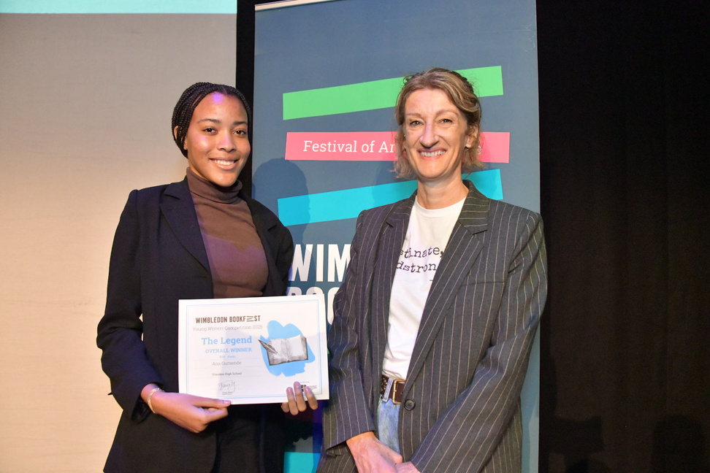
Prizes
26
SEN
Young
Writers
Competition
Every student that is entered will receive a certificate.
Winners, Runners Up and Entrants that receive Distinctions will have their work published in the 2026 Wimbledon BookFest Anthology.
Winners and Runners Up will be invited to our Prize-Giving event at the New Wimbledon Theatre to receive their certificate and a copy of the anthology
One lucky overall competition winner will win an iPad!

Slide 4
Writing Prompts
26
SEN
Young
Writers
Competition
The Lighthouse
Singer in the spotlight
Sparkling Fairies
Tell the story of someone who lives in a lighthouse.
Describe a singer on stage under the spotlight.
Write about fairies who sparkle and glow!
Sun and Moon
Upon a Star
Write a poem describing the moon or the sun.
Tell the story of someone who wishes upon a star.

Slide 5
Writing Prompts
26
SEN
Young
Writers
Competition
Light in our Lives
Sunny Holiday
Candles on the Cake
Write about something or someone who lights up your life
Tell the story of a holiday you went on in the sun
Describe a birthday cake with 100 candles!
Lights in
the Sky
Bright Screen
Describe your favourite TV show or video game.
Write a poem describing fireworks or shooting stars.

Slide 6
Story Starters
26
SEN
Young
Writers
Competition
I made a wish on a shooting star and asked for...
2. The spaceship landed and the aliens invited me onboard...
3. The musician stepped into the spotlight and began to sing
4. In the forest, lived glowing fairies and wizards.
5. My favourite ride at the fairground is...

Slide 7

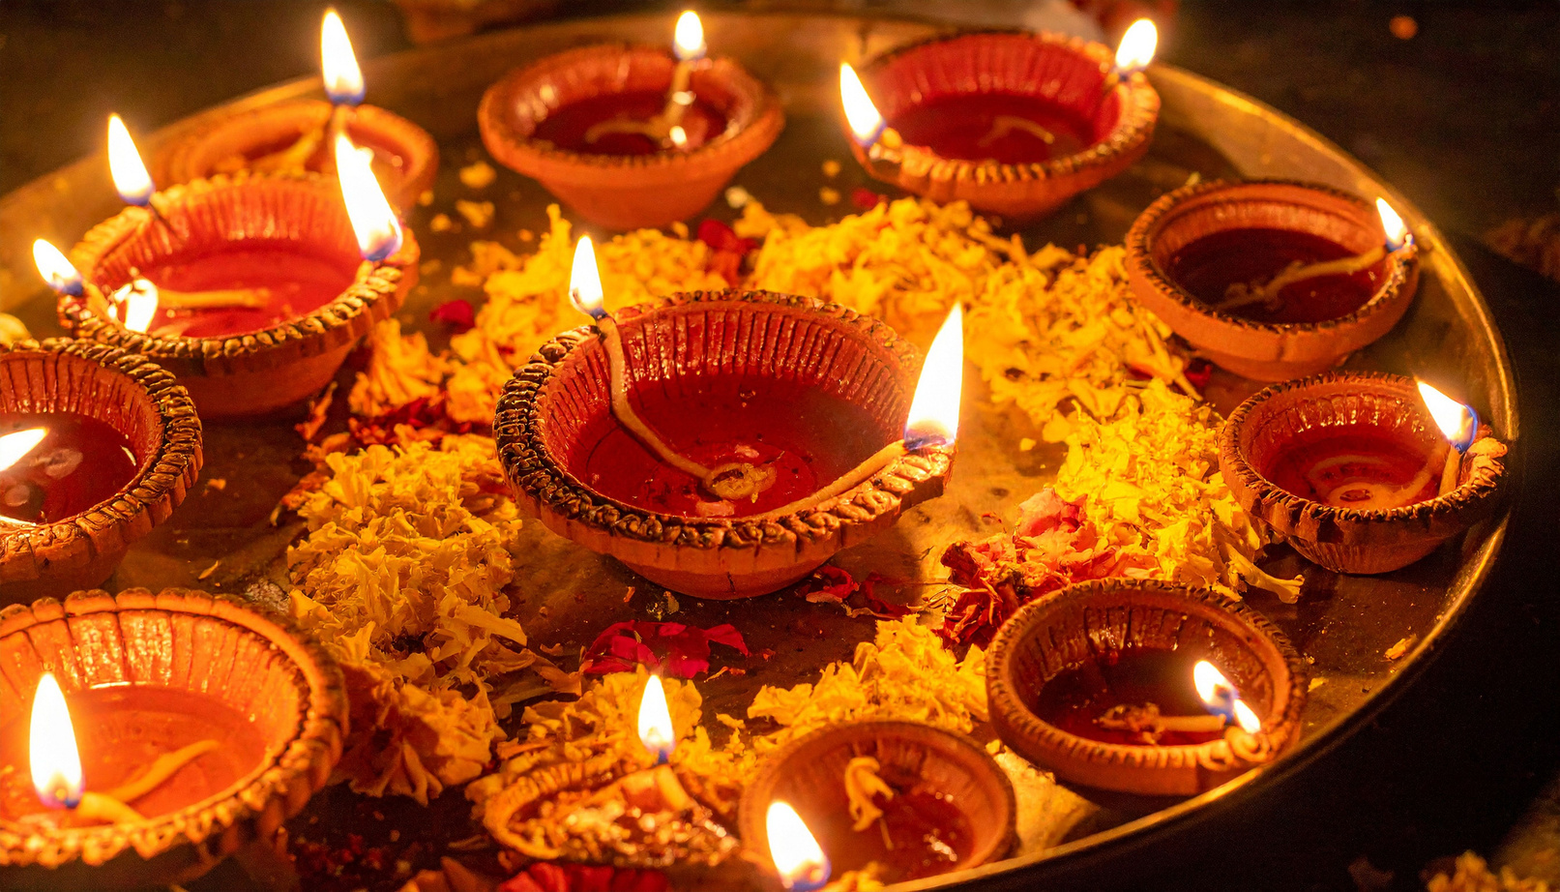
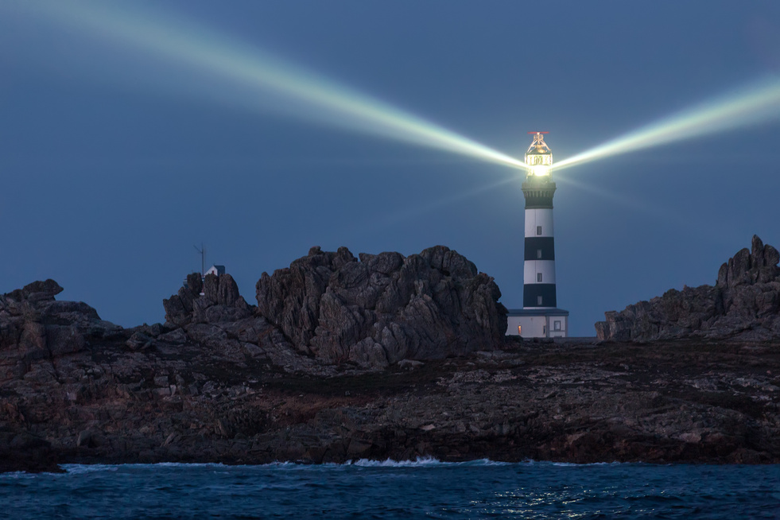
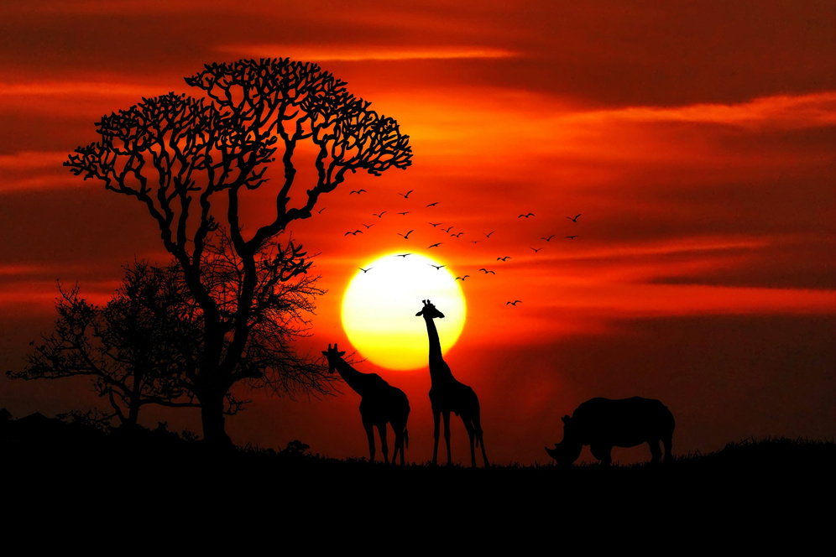


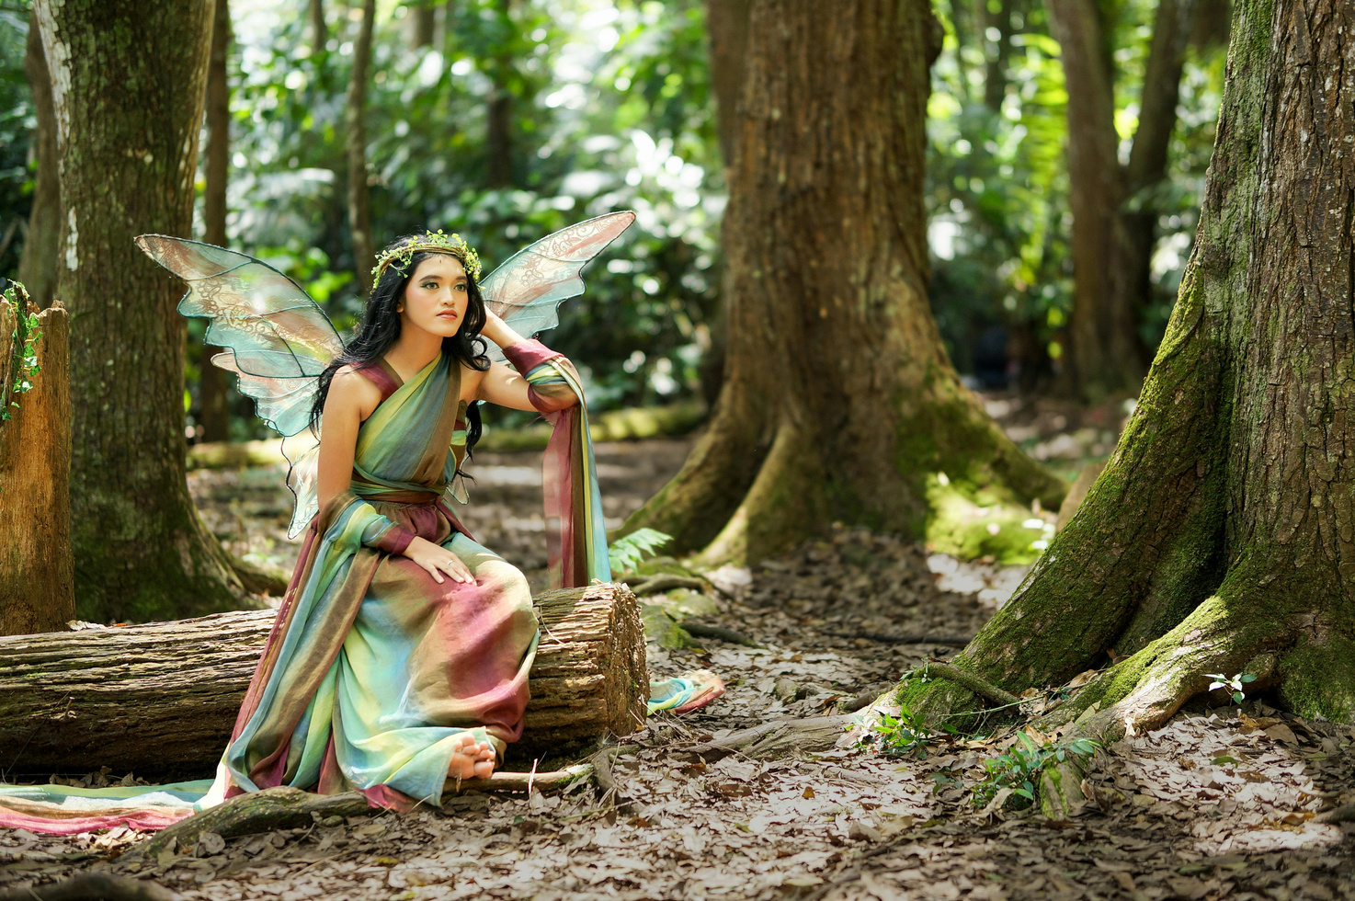

Image Bank
26
SEN
Young
Writers
Competition
Do any of these pictures spark your imagination?

Slide 8
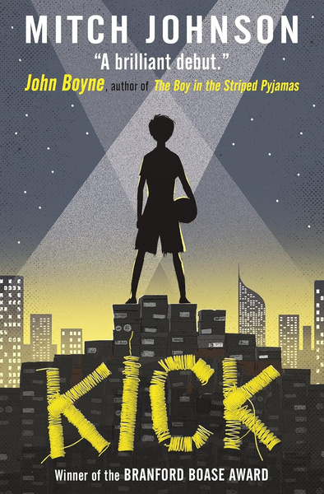

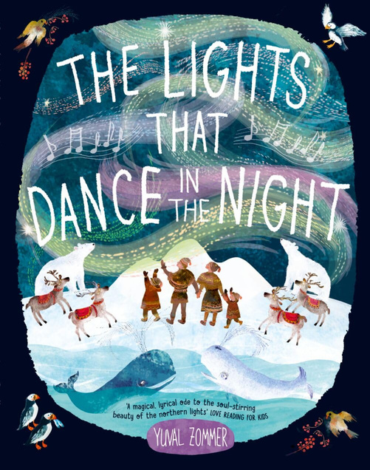
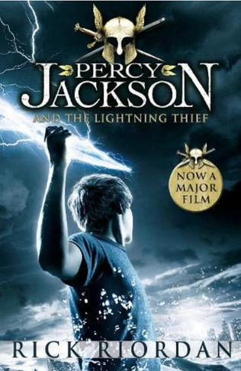
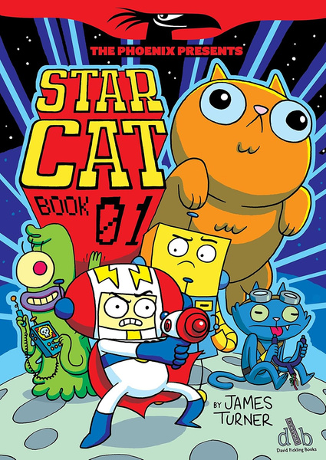



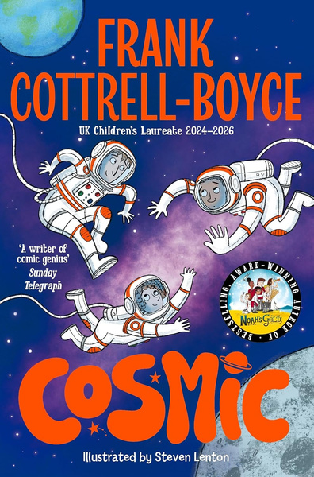
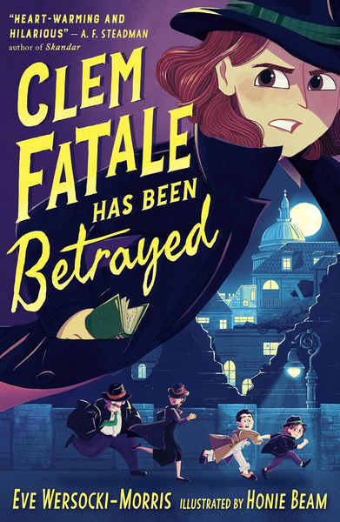
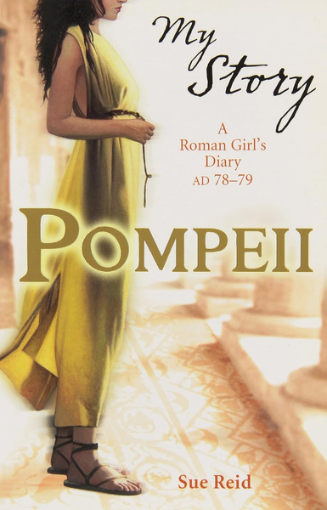
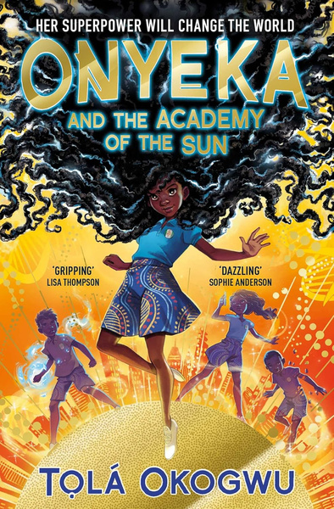
Reading Recommendations
26
SEN
Young
Writers
Competition
All the best writers are readers too! Use these books to find inspiration for your story or poem.

Slide 9


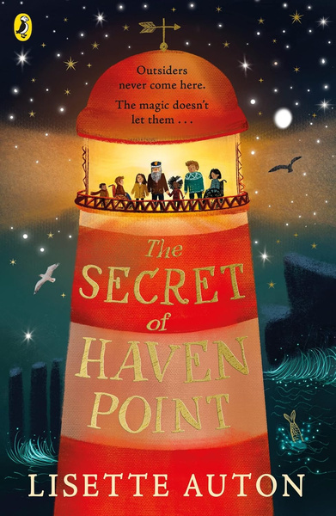
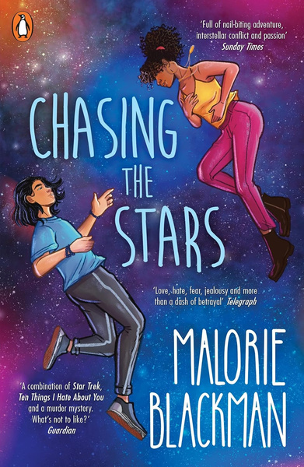
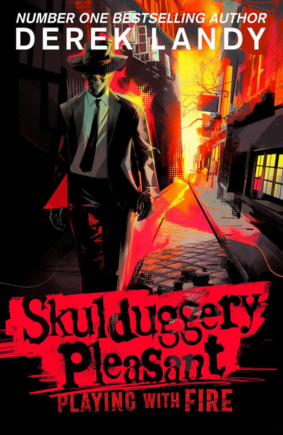
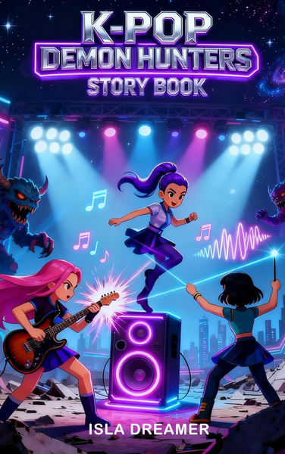
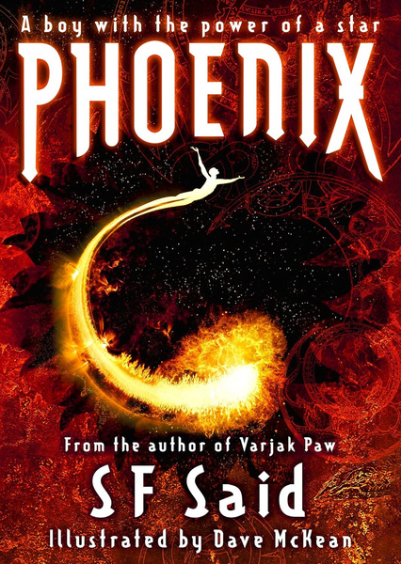
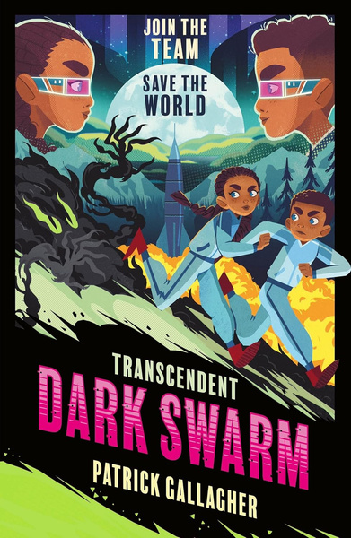
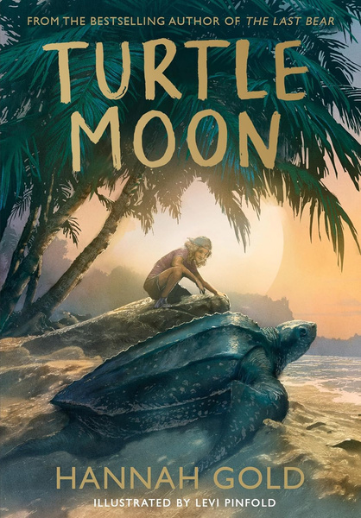
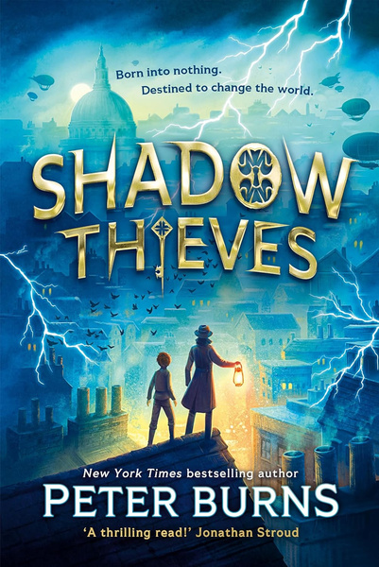
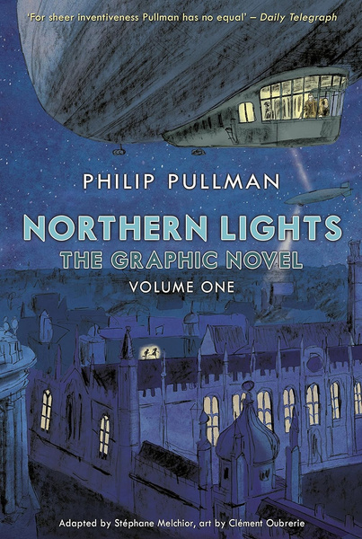
Reading Recommendations
26
SEN
Young
Writers
Competition
All the best writers are readers too! Use these books to find inspiration for your story or poem.

